Slide 1
Welcome to Catholic Health Long Term Care buildings

Slide 2
Introduction
This is an overview of some specific topics to our Catholic Health Long Term Care buildings
Any questions please always feel free to ask the specific building’s Administrator, Director of Nursing, Associate Director of Nursing or Nurse Managers

Slide 3
Contents
Corporate Integrity Agreement
Abuse/Neglect Prevention Training
Emergency Preparedness
Elopement
Protect and Save Our Skin Program
Care Plan
Needle sticks Prevention
Documentation
Diabetes
CPR
Occurrence Reporting
Controlled Substances
Infection Control

Slide 4

The Community Based Care Corporate Integrity Agreement
Corporate Integrity Agreement (“CIA”) between
The Office of Inspector General of the
Department of Health and Human Services (“OIG”)
and
Catholic Health System, Inc. and
Health & Community Based Care
https://www.youtube.com/embed/vbOUb9MC4Vw

Slide 5
Understanding the Community Based Care Corporate Integrity Agreement
The CIA was agreed to as part of settlement of qui tam (whistleblower) action brought by former Catholic Health employees on behalf of the United States, which alleged that Catholic Health subacute care facilities provided medically unnecessary rehabilitation services.
Purpose of CIA is “to promote compliance with the statutes, regulations, and written directives of Medicare, Medicaid, and all other Federal health care programs.”

Slide 6
Understanding the Community Based Care Corporate Integrity Agreement
The CIA applies specifically to Catholic Health’s subacute
rehabilitation facilities: Father Baker Manor (“FBM”) and The McAuley
Residence (“TMR”), and any other subacute rehabilitation facilities in
which Catholic Health has an ownership or control interest.
Effective Date of CIA is October 19, 2017.
Term is five (5) years.

Slide 7
Understanding the Community Based Care Corporate Integrity Agreement
Corporate Integrity Obligations
Catholic Health must maintain a full time Compliance Officer
a member of senior management
reports directly to Catholic Health CEO
not subordinate to General Counsel or CFO, or have responsibilities of legal counsel

Slide 8
Understanding the Community Based Care Corporate Integrity Agreement
Compliance Officer Responsibilities:
Develop and implement policies, procedures and practices designed to ensure compliance with CIA and Federal health care program requirements.
Make reports regarding compliance matters, at least quarterly, to the Board of Directors of Catholic Health.
Monitor day-to-day compliance activities and reporting obligations under CIA.

Slide 9
Understanding the Community Based Care Corporate Integrity Agreement
Catholic Health must maintain a Community Based Care Compliance Committee
- must include the Compliance Officer as chair,
  Executive Vice President, President and CEO, Catholic Health Home & Community Based Care
Chief Operating Officer, Home & Community Based Care
Director of Finance, Home & Community Based Care
System Director Human Resources, Home & Community Based Care
Manage, Internal Controls and Tax
Must support Compliance Officer fulfill his responsibilities
Must meet at least quarterly

Slide 10
Understanding the Community Based Care Corporate Integrity Agreement
Board of Directors Compliance Obligations
Audit Committee responsible for review and over sight of matters related to compliance with Federal health care program requirements and CIA
meet quarterly to review and oversee compliance program, including performance of Compliance Officer and Compliance Committee
submit to OIG description of documents and materials it reviewed and steps it has taken in its oversight role
adopt an annual resolution signed by each member of Audit Committee summarizing its review and oversight of Catholic Health’s compliance with Federal health care program requirements and the obligations of CIA

Slide 11
Understanding the Community Based Care Corporate Integrity Agreement
Management Certifications
The following must annually certify that they have taken steps to promote compliance with CIA and Federal health care programs as they relate to areas under their supervision:
Catholic Health President and CEO
Executive Vice President, Catholic Health, President and CEO, Home & Community Based Care
Chief Operating Officer of Home & Community Based Care
Senior Vice President of Finance
Vice President of Patient and Resident Financial Services
Director of Home & Community Based Care Billing
Director of Human Resources for Home & Community Based Care
The McAuley Residence Administrator
Father Baker Manor Administrator

Slide 12
Understanding the Community Based Care Corporate Integrity Agreement
Written Standards
Develop and implement written policies and procedures of its compliance program, including compliance with CIA
Assess and update at least annually
Make available to all “Covered Persons”
These policies are available to all associates on MFiles

Slide 13
Understanding the Community Based Care Corporate Integrity Agreement
What is a “Covered Person”?
all officers and directors of Catholic Health Community Based Care
all associates of Catholic Health Community Based Care & those corporate associates who provide services for Community Based Care
all physicians and non-physician practitioners who are members of Community Based Care medical staffs
all contractors, subcontractors, agents and other persons who furnish patient care items or services or who perform billing or coding functions at Community Based Care facilities

Slide 14
Understanding the Community Based Care Corporate Integrity Agreement
TRAINING AND EDUCATION
Covered Persons
In addition to completing the annual mandatory training, at least annual training regarding CIA requirements and compliance program, Federal health care program requirements, including requirements of Stark Law and Anti-Kickback Statute

Slide 15
Understanding the Community Based Care Corporate Integrity Agreement
Board of Directors
At least 2 hours of training by February 16, 2018 addressing:
responsibilities of Board members with respect to review and oversight of the compliance program, including OIG guidance on Board member responsibilities
New Board Members are required to complete training within 30 days of joining

Slide 16
Understanding the Community Based Care Corporate Integrity Agreement
REVIEW PROCEDURES
Engagement of Independent Review Organization (“IRO”) to conduct:
MDS Review – to determine whether items and services reimbursed by Medicare at FMB and TMR were medically necessary, appropriately documented, and correctly coded, submitted and reimbursed, and
Therapy Assessment Review – to assess the effectiveness, reliability and thoroughness of Catholic Health’s oversight of therapy services.

Slide 17
Understanding the Community Based Care Corporate Integrity Agreement
ANNUAL RISK ASSESSMENT AND INTERNAL REVIEW PROCESS
Identify and address risks associated with participation in Federal health care programs;
Develop and implement internal audit work plans related to identified risk areas;
Develop corrective action plans in response to the results of internal audits, and track implementation of such corrective action plans.

Slide 18
Understanding the Community Based Care Corporate Integrity Agreement
DISCLOSURE PROGRAM
Catholic Health must provide a mechanism for individuals to disclose identified issues or questions regarding compliance with Federal health care programs to the Compliance Officer or someone else not in disclosing person’s chain of command;
disclosures to be logged, reviewed and resolved under direction of Compliance Officer.

Slide 19
Understanding the Community Based Care Corporate Integrity Agreement
Compliance Hotline
1-888-200-5380

Slide 20
Understanding the Community Based Care Corporate Integrity Agreement
WE MUST SCREEN FOR INELIGIBLE PERSONS
Policies and procedures must be in place to ensure individuals excluded from participation in Federal health care programs are not engaged as Covered Persons.
On a monthly basis Compliance Department staff conduct a “sanction check” of all Community Based Care Covered Persons
WE MUST PROVIDE NOTIFICATION OF OIG OF GOVERNMENT INVESTIGATION
OR LEGAL PROCEEDING
Conducted or brought by a government entity alleging Catholic Health has engaged in fraudulent activities or committed a crime.

Slide 21
Understanding the Community Based Care Corporate Integrity Agreement
OVERPAYMENTS
Catholic Health must have in place policies and procedures to identify, quantify and repay overpayments from Federal health care programs.
REPORTABLE EVENTS
- Means anything that involves
  a substantial overpayment
  a probable violation of criminal, civil or administrative laws applicable to any Federal health care program for which penalties or exclusion may be authorized
  employment of Ineligible Persons
  filing of bankruptcy

Slide 22
Understanding the Community Based Care Corporate Integrity Agreement
IMPLEMENTATION AND ANNUAL REPORTS
Implementation Report
- due on or about February 16, 2018
- summarizes status of implementation of the CIA training, identification of certifying employees, description of risk assessment and internal review process, disclosure program, copies of policies and procedures, information regarding the IRO

Slide 23
Understanding the Community Based Care Corporate Integrity Agreement
Annual reports on compliance with CIA requirements
required Board Resolutions
certification from IRO
summary of disclosures, audits, Reportable Events
certifications of certifying employees concerning compliance with CIA

Slide 24
Understanding the Community Based Care Corporate Integrity Agreement
OIG INSPECTION, AUDIT AND REVIEW RIGHTS
To verify and evaluate compliance with CIA, OIG may conduct interviews, examine or request copies of Catholic Health’s books, records or other documents, and conduct on-site review of any Catholic Health locations.

Slide 25
Understanding the Community Based Care Corporate Integrity Agreement
BREACH AND DEFAULT PROVISIONS
Stipulated Penalties for failure to comply with certain obligations.
$2,500 per day Stipulated Penalty for failure to meet obligations to maintain policies, procedures and positions required under CIA, and to submit reports required under CIA.
$1,500 per day Stipulated Penalty for failing to grant access to OIG to books, records, personnel or facilities.
$50,000 Stipulated Penalty for each false certification submitted.
$1,000 per day Stipulated Penalty for each day Catholic Health fails to comply fully and adequately with any obligation under CIA.

Slide 26
Understanding the Community Based Care Corporate Integrity Agreement
Catholic Health may be excluded from participation in the Medicare Program for Material Breach of CIA
1. Material breach means:
  repeated or flagrant violations of obligations under CIA
  failure to report a Reportable Event, take corrective action or make appropriate refunds
  failure to respond to demand for Stipulated Penalties
  failure to engage and use IRO
  2. In these instances, the OIG will provide a Notice of Breach and Intent to Exclude
3. Catholic Health will have an Opportunity to Cure
4. If the Material breach is not cured the OIG will issue an Exclusion Letter
Dispute Resolution
  Limited administrative review procedures for disputes arising under CIA.

Slide 27
Associate Responsibilities
Associates have a duty to report all Compliance Concerns
Associates are protected from retaliation for reporting a compliance concern in good faith.
All associates are responsible for complete, accurate, and timely documentation.

Slide 28
Associate Responsibilities
As associates of Catholic Health, we have a responsibility to cultivate a culture of compliance and integrity. Culture begins with you.

Slide 29
Catholic Health Corporate Compliance
Kimberly Whistler, Esq.
Corporate Compliance & Privacy Officer
144 Genesee Street, 6th Floor-West, Buffalo, NY 14203
Office: 716.821.4471 Fax: 716.821.4460
E-Mail: kwhistler@chsbuffalo.org web: www.chsbuffalo.org
Compliance Hotline
  Available toll-free 24/7
  Phone 1.888.200.5380
  All reports are confidential
  Associates have the right to remain anonymous if they chose

Slide 30
Regulations state…
§483.12 Freedom from Abuse, Neglect, and Exploitation
The resident has the right to be free from abuse, neglect, misappropriation of resident property, and exploitation as defined in this subpart. This includes but is not limited to freedom from corporal punishment, involuntary seclusion and any physical or chemical restraint not required to treat the resident’s medical symptoms.

Slide 31
What is Abuse?
“Abuse,” is defined at §483.5 as “the willful infliction of injury, unreasonable confinement, intimidation, or punishment with resulting physical harm, pain or mental anguish. Abuse also includes the deprivation by an individual, including a caretaker, of goods or services that are necessary to attain or maintain physical, mental, and psychosocial well-being. Instances of abuse of all residents, irrespective of any mental or physical condition, cause physical harm, pain or mental anguish. It includes verbal abuse, sexual abuse, physical abuse, and mental abuse including abuse facilitated or enabled through the use of technology.”

Slide 32
TYPES OF ABUSE
Verbal Abuse- oral, written, or gestured communication, or sounds, to residents within hearing distance, regardless of age, ability to comprehend, or disability.
  Examples: Calling a patient/resident names, yelling/screaming/shouting at a resident/patient, threatening and intimidation, talking to them like a child, blaming them for behavior
Sexual Abuse- non-consensual sexual contact of any type with a resident.
  Examples: inappropriate touch, coercion to perform sexual acts, sexual photography, Rape

Slide 33
Types of Abuse
Mental/psychological/emotional Abuse- verbal or nonverbal conduct which causes or has the potential to cause the resident to experience humiliation, intimidation, fear, shame, agitation, or degradation.
  Examples: Berating, Ignoring, Intimidation, Making resident feel guilty, Embarrassing the resident/patient, taking photos/videos of residents in any form and posting them to social media with out consent
Physical Abuse- physical assault on a resident/patient
  Examples: Hitting, punching, fighting, slapping, spitting, force feeding

Slide 34
Types of Abuse
Involuntary Seclusion- sequestering a resident to their room or away from other residents.
  Examples: forcing a resident to stay in room against will, turning their wheelchair to the wall, locking them in their room

Slide 35
Types of abuse
  Misappropriation of resident property- the deliberate misplacement, exploitation, or wrongful, temporary, or permanent use of a resident’s belongings or money without the resident’s consent.
  Examples: stealing or embezzling money/personal items, placing funds in separate interest-bearing accounts.

Slide 36
Neglect
Neglect is the failure of the facility, its employees or service providers to provide goods and services to a resident that are necessary to avoid physical harm, pain, mental anguish, or emotional distress.
Neglect can be intentional or NOT intentional

Slide 37
Examples of Neglect
Incorrect body positioning (may lead to skin breakdown/contractures)
Lack of Toileting/incontinent care (may lead to skin breakdown, increase risk of falls, indignity)
Lack of assistance eating/drinking (may cause malnutrition/dehydration)
Poor hand washing techniques (may lead to infection)
Lack of assistance with participating in activities (may lead to withdrawal/isolation)
Ignoring call bells or call for help (may lead to increase falls)

Slide 38

Signs of Abuse
Someone whom has been a victim of abuse, you may see:
  Physical marks like bruising, skin tears
  Withdrawal
  Social isolation
  Depression
  Resident acting differently
  Sudden or unexplained changes in the resident’s behaviors and/or activities, such as fear of a person, activity or place, or feelings of guilt or shame.

Slide 39

Reporting abuse
Everyone is responsible for knowing signs of abuse, and if you see any abuse you must report it!
Any acts of abuse, even if you feel the source not credible, must be reported to Administration/Supervisor immediately!
Any and all, actual or suspected abuse must be reported to the State Health Department with in 2 hours, so time is of the essence.

Slide 40
If you know something is wrong, or someone is doing something against policy or best practice, SPEAK UP!
If uncomfortable telling that person, involve the supervisor right away!
We are here to protect our patients and residents
If you know someone did something wrong but did not speak up you can be liable for the abuse even if you were not whom cause the abuse.

Slide 41
Preventing Abuse
Follow policy and best practices. Rules/Regulations/policy are in place for reasons, and these keep our residents/patients from harm.
Treat our residents with empathy not apathy
Try to see their lives from their perspective- how comfortable you would feel if not knowing what is going on and scared

Slide 42
Preventing abuse
Know yourself and own limits, if starting to get frustrated with a resident/patient, ask for help, bring someone with you to do care
Explain a task prior to performing the task, so the resident/patient knows what to expect
Report any signs of abuse or concerns from resident- this may include other staff or family members
ALWAYS SHOW DIGNITY, COMPASSION AND RESPECT TO ALL!

Slide 43
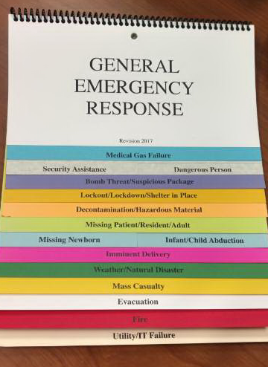
What to do if you are in the facility at the time of an emergency:
A notification page will be announced on the facility overhead system in plain language like “Fire, unit 6”
Each unit/department or work area has a color coded flip chart to provide guidance to associates in situations requiring immediate action such as
  Fire
  Evacuation
  Weather/Natural disaster
  Dangerous Person
  Missing Patient

Slide 44

In case of a fire: RACE
R-Rescue-
  Remove people
  Ensure associates safety while removing patients
  Don’t use elevators
A-Alarm
  Sound the alarm
  Upon finding a fire yell fire and location until associates respond
  If applicable go to the nearest pull station and activate
  Call 55555 to notify switchboard of fire and location
C-CONFINE
  Secure the area
  Close all doors and windows
  Try to extinguish the fire if you can do so safely
E-EVACUATE
  Will only take place at the direction of the incident commander/fire dept.
  Do not use elevators
  Several evacuation types:
    Horizontal- the adjacent smoke compartment
    Vertical- move one floor down, using the exit stairs
    Building- all patients & visitors will be moved from the building to a safe area
    Mark evacuated rooms with door signs

Slide 45

Emergency Preparedness
For any questions regarding facility emergency preparedness, at each Supervisor Office there is a RED BOOK, a 3 ring binder, that can be consulted for all emergencies. This has comprehensive procedures and contacts that if any emergency occurs, you will have a reference on how to handle it.

Slide 46
Elopement/ Missing Resident
It is the duty of the facility to keep residents/patients safe
Always be mindful of where your residents are
Do not leave Exit doors open
Mindful of patients or residents whom are “wanderers” and take their safety very seriously
Wander alert systems are in our buildings, if a resident/patient attempts to exit an alarm goes off, please do not silence any alarms until safety of residents are determined

Slide 47
ELOPEMENT
Missing Patient/Resident
When it is determined that a patient/resident is suspected missing:
An overhead announcement is made for the specific unit
A command post is established in a centrally located area.
All staff on all units/departments search their immediate area.
Upon completion of the search, the unit/department head/designee contacts
the command post.
If the patient/resident is located an overhead announcement of all clear is
made.

Slide 48
If the individual is not found, the Nursing Supervisor/Nurse Manager:
  Contacts the DON & Administrator within 15 minutes of the event
  Initiates the Elopement Search Assignment form.
  Secures and isolates the patient’s/resident’s room.
  Contacts all available staff for search assignments.
  Organizes an internal/external search. The external search will include the grounds within an approximate ¼ mile radius of the building.
  Assigns monitors for all accessible egresses.

Slide 49
Search process:
Police Department and the family are notified within 30
minutes of the incident.
The police will be provided with the following information:
Time discovered missing.
Last known location.
Description of appearance.
Cognitive status and native language.
Street Address information that is significant/meaningful to the patient/resident.
Any unique identifying information.
Patient’s/Resident’s ID Packet.
For residents/patients without an ID packet, a detailed
description will be provided along with their photo.

Slide 50
Search process
If the resident/patient has not been located following the
search, the Administrator/DON
  Calls the NYSDOH.
  Works in conjunction with the outside authorities.
All media inquiries are handled by Catholic Health Public Relations
Department.

Slide 51
Once the Patient/resident is found, the Nursing Supervisor
Completes a patient/resident nursing assessment and arranges emergent care, if indicated.
Notifies the search team, authorities, and family.
Notifies the Administrator/DON
Places the Patient/resident on visual 15 min. checks X’s 24 hrs..
Keeps in contact with the ED for all transferred patients/residents.

Slide 52
P&SOS Program: Protect and Save Our Skin
Systematic evidence based interdisciplinary program
Designed to prevent the development of skin impairments
To recommend treatment options to promote wound healing consistent with clinical best practices.
Goals
Prevent and Treat Pressure Ulcers using evidenced based best practices supported by an IDT
Insure high quality fiscally responsible care to our Residents/Patients in compliance with state and federal regulations
Provide patient/resident/family education

Slide 53
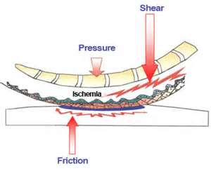
Definition by National Pressure Ulcer Advisory Panel (NPUAP)
A pressure ulcer is a localized injury to the skin and/or underlying tissues usually over bony prominence, as a result of pressure, or pressure in combination with shear.
Notes:
NPUAP = National Pressure Ulcer Advisory Panel

Slide 54
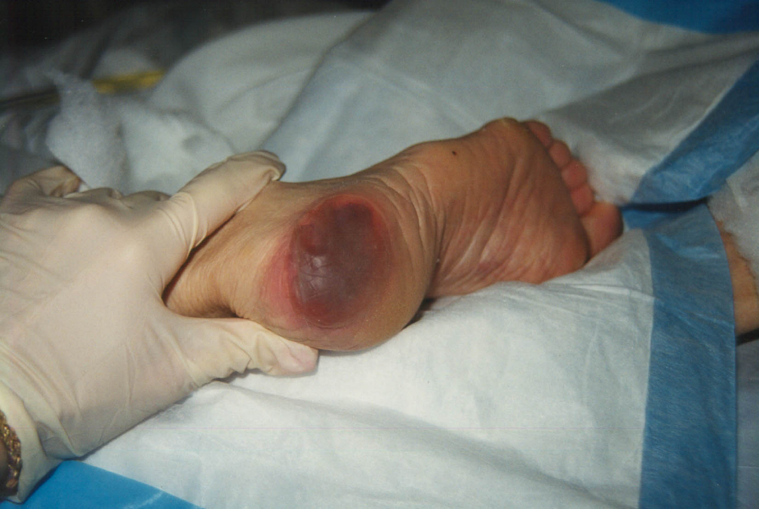
Deep Tissue Injury
Purple or maroon localized area of discolored skin open, intact, or blood-filled blister due to damage of underlying soft tissue from pressure and/or shear.

Slide 55
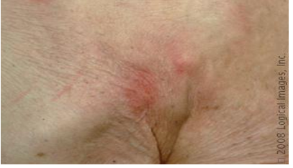
Stage 1
Intact skin with an area
of nonblanchable
redness. Can be
painful, area can be
firm or soft.
It signals “AT RISK” for
tissue breakdown.

Slide 56
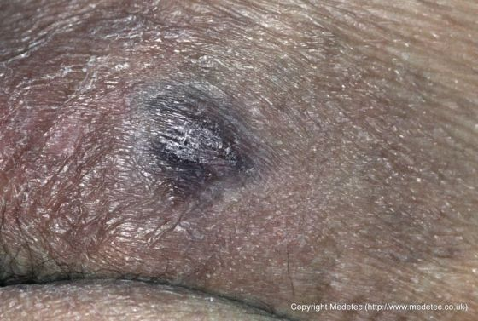
Stage 1
May be difficult to detect
in individuals with dark
skin tones. Darkly
pigmented skin may not
have visible blanching;
its color may differ from
the surrounding area.

Slide 57
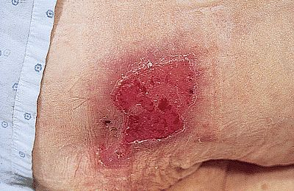
Stage 2
Partial thickness
tissue loss.
(loss of the dermis)
Shallow, open or
ruptured serum
filled blister without
slough or bruising

Slide 58
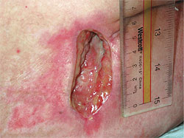
  Stage 3
  Full thickness tissue
  loss. Subcutaneous fat
  may be visible but bone,
  tendon or muscle are not
  exposed. Slough may
  be present but does not
  obscure the depth of
  tissue loss. May include
  undermining and
  tunneling.

Slide 59
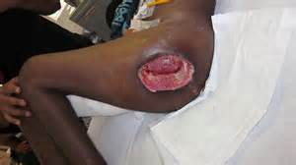
  Stage 4
  Full thickness tissue loss with exposed bone, tendon or muscle. Slough or eschar may be present on some parts of the wound bed. Often includes undermining and tunneling.

Slide 60
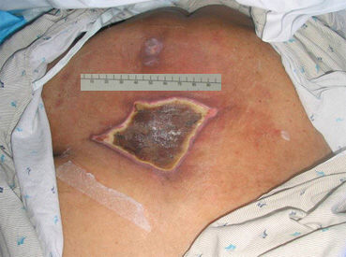
  Unstageable
  Full thickness tissue loss in which the base of the ulcer is covered by slough (yellow, tan, gray, green or brown) and/or eschar (tan. Brown or black) in the wound bed.

Slide 61
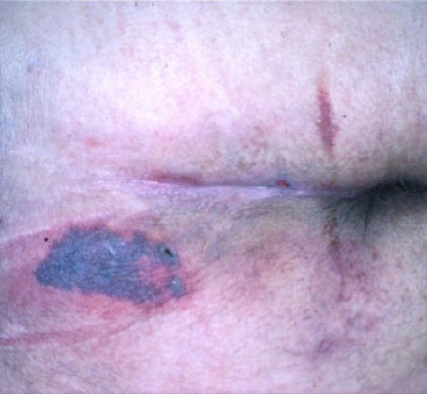
Kennedy Terminal Ulcer
A pressure ulcer some people
develop as they are dying
Usually presents on the sacrum
Can be shaped like a
  Pear
  Butterfly
  Horseshoe
Can have the colors of
  Red
  Yellow
  Black
Purple Sudden onset
In the beginning looks much like an abrasion
It becomes deeper and turns colors
  presents as a blister or Stage II
  Can rapidly progress to Stage III or IV
  Red/purple progresses to yellow and black

Slide 62
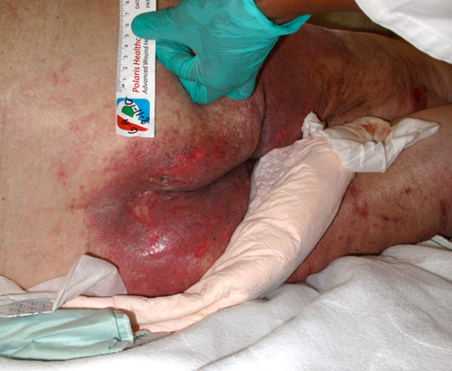
P&SOS Program
Incontinent Associated Dermatitis (IAD)
Diffuse area of erythema, scaling, vesicles, pustules, weeping, pain/itching, or edema. Partial thickness skin loss may also occur secondary to maceration and friction. May see fungal or bacterial secondary infections

Slide 63
Incontinence associated dermatitis (IAD)
  from the effects of prolonged contact with urine, stool, and containment devices on the skin (adult diapers or briefs)
Adult diapers or briefs
  multilayer disposable garments containing a superabsorbent polymer.
  the polymer wicks and traps moisture in the brief.
  Traps heat and moisture
    which may cause redness and inflammation that can progress to skin erosion.
    can lead to increased pressure against the skin
The three essentials of IAD prevention
  to cleanse
  moisturize
  protect

Slide 64
Prevention of Skin Impairments
Pressure Redistribution per CCP
    Apply booties, wedges, WC cushions, splints per Kardex
    Monitor for soiling, tears, fit. Check for Bottoming out. Check plugs! (mattresses, specialty mattresses, WC cushions)
Silent ulcers
    Found under casts, splints, compression stockings, etc.
Proper positioning
    30 degrees side lying position
    HOB should never be greater than 30° for prolonged periods of time
    Prevent friction & shearing

Slide 65
Why is positioning important?
Basic procedures health care providers in long-term care facilities perform most frequently is that of changing the resident’s position.
Any position, after a period of time becomes uncomfortable and then painful.
The independent person has the ability to assume a great variety of positions, the dependent person may be limited.
The resident who is unable to move limbs freely to change positions or who is partially or totally dependent on the nursing staff because of injury or disease must be moved at regular intervals.

Slide 66
P&SOS Program
30 degree lateral position
Pillows are placed under the head, shoulder, & leg. This position lifts up the hip to avoid pressure on the hip. T&P q 2hrs.or per care plan

Slide 67
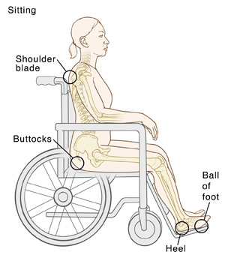
P&SOS Program
Correct body alignment when sitting, but you can see where the pressure points are. Residents dependent on staff to move should be repositioned q 1 hr.

Slide 68
Comprehensive Care Plans
§483.21(b)
Each resident will have a person-centered comprehensive care plan developed and implemented to meet his other preferences and goals, and address the resident’s medical, physical, mental and psychosocial needs.
Personalized Care plans must be given to patient/resident and/or family representative with in 48 hours. They are reviewed by the team with in 21 days, quarterly and any time there is a significant change in the patient.

Slide 69
Regulations
§483.21(b) Care plans must be person-centered and reflect the resident’s goals for admission and desired outcomes. Person-centered care means the facility focuses on the resident as the center of control, and supports each resident in making his or her own choices. Person-centered care includes making an effort to understand what each resident is communicating, verbally and nonverbally, identifying what is important to each resident with regard to daily routines and preferred activities, and having an understanding of the resident’s life before coming to reside in the nursing home.

Slide 70
§483.21(b) Facilities are required to develop care plans that describe the resident's medical, nursing, physical, mental and psychosocial needs and preferences and how the facility will assist in meeting these needs and preferences. Care plans must include person-specific, measurable objectives and timeframes in order to evaluate the resident’s progress toward his/her goal(s).
This is done through the Inter Disciplinary Team or IDT to encompass the whole patient. The team consists of Nursing, Therapy, Dietary, Social work, and Activities department to create a collaborative care plan. A well developed care plan looks at the patient/resident as a whole human being with unique characteristics and strengths.

Slide 71
Examples of Problems to address on a Comprehensive Care Plan
Falls
Potential for skin impairments, or actual skin impairments
Resident choices
Discharge Plan
Behavior issues including any sexual behaviors, elopement and recitative to care
Nutrition
Psychiatric diagnosis's like depression, anxiety, PTSD
Medical diagnosis and treatments for the disease process
Any change in patient’s condition
Remember: what is on the care plan has to be followed.

Slide 72
Care Plans
Long Term Care has very strict rules when it comes to Care Plans
EVERYTHING ON THE CAREPLAN MUST BE FOLLOWED
The care plan is developed to optimize our care of our patient and resident
Please always check the care plan before providing any care- specifics ADL’s like transferring and toileting have certain care levels that must be followed- like 1 person/2 person assist and if not perform specific to the patient/resident care need could cause injury

Slide 73

Preventing Needlestick Injuries

Slide 74
What is a needlestick?
A “needlestick” means a break in the skin from a needle or other “sharp” such as a scalpel.

Slide 75
What infections are caused by needlestick injuries?
An injury from a contaminated needle exposes workers to blood borne pathogens that can cause serious or fatal infections.
The most serious are:
  HIV
  Hepatitis B
  Hepatitis C

Slide 76
How common are needle stick injuries?
It is estimated that more than 800,000 injuries occur annually in the United States from needles and other sharps.
More than half of these injuries are never officially reported.
You should always report your injuries immediately to ensure that you receive proper follow-up medical care.

Slide 77
Where do these injuries occur?
These injuries have been reported from all healthcare settings, including:
  Ambulatory settings
  Physician offices
  Nursing homes, skilled nursing facilities
  Home health, assisted living
  Hospitals

Slide 78
Needlestick injuries can occur at any time during the use or disposal of a device
15% during or related to device disposal
5% during device recapping
Needlesticks in our division have
occurred related to:
Failure to properly engage safety
mechanism on syringes
Safety awareness r/t handling of used
clysis strips
Safety awareness r/t safe handling of
insulin pens after use
Safety awareness r/t proper disposal
of used lancets
40% during device use
40% after device use, before disposal

Slide 79
How to protect yourself, be aware!
Other factors that contribute to needlesticks are:
  Lack of safety devices
  Failure to engage safety device after use
  Inconveniently placed or overfilled sharps containers
  Busy, congested environments with frequent distractions and rushing

Slide 80
How to protect yourself, be prepared!
Prior to procedure using sharps:
  Ensure all equipment is available and within arms reach
  Ensure lighting is adequate
  Place a sharps container nearby and know where it is located
  Assess patient’s/resident’s capacity for cooperation; request additional help if needed
  Instruct patient/resident to avoid sudden movement
  Do not expose sharps/needles until moment of use and keep pointed away from user.

Slide 81
How to protect yourself, be prepared!
During the procedure
  Maintain visual contact with sharps during use
  Remain aware of positioning of other staff to avoid accidental contact
  Do not pass sharps by hand; place and retrieve from predetermined centralized location/tray
  Alert other staff when placing or retrieving sharps

Slide 82
How to protect yourself, be prepared!
Post-procedure:
  Activate safety features of sharps and check (visual & auditory) to ensure features are activated and locked in place.
  Ensure all sharps are accounted for and visible.
  Check trays, linens, waste materials prior to handling for sharps accidently misplaced or left behind
  Keep fingers away from tip of device when disposing, and avoid placing hands close to the opening of the sharps container.

Slide 83
Importance of Documentation in Nursing
Proper documentation can help you avoid med errors and legal problems.
There is new legislation continually being enacted designed to protect people receiving medical care.
  Documentation allows you to demonstrate how you provided the patient with a standard of care that meets the institutional and board standards in the state where you practice.

Slide 84
Why is there so much emphasis on documentation?
The old saying “if it’s not documented, it wasn’t done” has never been more true as state and federal governments continue to enact legislation to protect various healthcare consumers.
  The late 80’s and early 90’s showed increased interest in the elderly resulting in legislation and regulations relating to LTC facilities and new litigation possibilities occurred.
  Proper documentation reflects the quality of care that you gave and is evidence that you acted as required or ordered.

Slide 85
Importance of Documentation in Nursing
Failure to provide timely, accurate documentation is unsafe, and irresponsible nursing care.
Failure to document the care provided
  could put a patient at risk for getting a double dose of a medication(s)
  unnecessary treatments
  or a discontinuity in medical care.
When you assume care for a patient, you are saying that you will provide the patient with a standard of nursing care.
If it is determined by the court that you breached your duty by not providing the patient with the standard of care recognized by the state in which you practice, then you could be liable for damages and end up losing your nursing license

Slide 86
When Documenting Don’t
Use uncommon abbreviations. Avoid abbreviations that are non-medical or made up and never add texting language in patient records.
Include subjective data. For example, refrain from documenting judgments you make about a patient like ‘He is an angry old man,’ ‘She is irresponsible and rude,’ or ‘She’s acting like a child’
Leave large sections of time blank. Remember if it wasn’t documented it wasn’t done!
Don’t add in late entries. Try to squeeze in or add a late entry to the patient’s record to look as if it was documented on time.
Fail to document a change. It’s extremely important that you document any change in patient/resident status that occurs during your shift. Never document that an incident report was completed. Just document the circumstances of the event.
Include meaningless jargon. Avoid long unspecific notes. Instead stick to the basics and make the entry concise.

Slide 87
When Documenting Do
Use objective data. If a patient refused his medications document exactly what occurred in the chart. For example, you could document the following: “After giving the patient his oral medications he threw the medications on the floor and said, ‘I refuse to take this poison!’”
Follow the standards of care. Document how you provided care according to the standards of care outlined by the state and facility where you practice.
Include nursing interventions. Add the interventions you provided and the patient’s response to the treatment.
Include any patient refusals. If a patient refused treatment, document the incident. Include the patient’s verbal and non-verbal response using as much objective detail as possible.
Include follow up care. Document how you followed up a medical situation with the appropriate patient care. For example, if the patient’s status changed and you notified the physician, document the change in patient status and that you notified the physician. Be sure to include the changes the physician made and the patient’s response to those changes.

Slide 88
When Documenting Do
Make documentation a continuing, ongoing process. Do not leave large spaces of time in the patient’s chart. Although you may know that you were there observing the patient, the court only has the patient’s medical record to go by and a blank area in the patient’s chart can be interpreted as a breach of duty.
Document the discharge teaching. Include in the chart how the patient demonstrated an understanding of the discharge plan.
Include what care you delegated. Document what you delegated to other staff members and when that care was provided. This demonstrates that you made sure the duties you delegated to the staff were provided to the patient in a timely manner.
Chart according to your five senses. Include terms like ‘I palpated a pea size lump,’ ‘I observed a yellow tint to the skin,’ ‘Skin was hot to touch,’ ‘Crackles were heard upon auscultation of the lower lungs,’ or ‘Urine was dark amber in color with a strong rancid odor’ in the patient’s chart.

Slide 89
Using “Copy and Paste” in documentation is tempting, but is it good nursing practice?
The temptation might be there to copy previous notes into your current note. Nothing has changed on the resident, so why not? Well, there are actually many risks associated with copying and pasting information into a resident record:
Resident safety and quality of care is at risk. (identical wording could indicate failure to reassess)
Insurance fraud (identical language day after day is an indicator of fraud to Medicare and other insurers)
Denial of payment (identical language may lead to a refusal of payment upon chart review)
Even if the resident’s condition is identical from day to day, you still are required to document in such a way as to reflect a current and accurate assessment and avoid the above issues.
Notes:
Electronic medical records have replaced old fashioned paper charting, and there are tools and functions available, that would appear to make our lives easier. The Copy/Paste function is one of those features. Imagine being on a busy unit, with many residents to chart on. Perhaps a few of your residents’ conditions do not change much from day to day.

Slide 90
The Daily Skilled Assessment Note is done by a RN, and a very detail overview of a patient/resident
Progress notes are utilized to describe a change of condition, or any diversion from the normal including incidents
Always be clear and concise in documentation

Slide 91
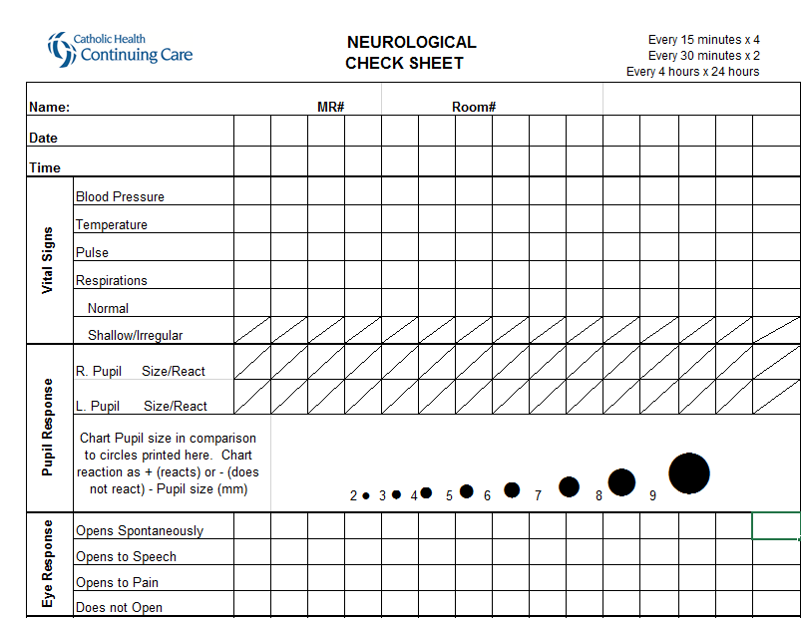
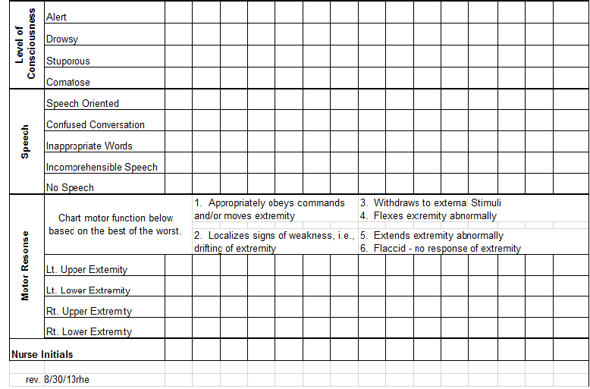
Neurological Checks
In the event of a suspected or actual head injury, can be witnessed or reported
  Patient/resident complaints of or exhibits symptoms indicating possible neurologic impairment:
  severe headache, vomiting, lethargy, change in level of consciousness, weakness or inability to move extremity, visual disturbances (blurring or double vision), and irregular respirations, etc.
  Completed as determined necessary by RN assessment of patient/resident status or When ordered by the provider.

Slide 92
Behavior Charting
Behavior Charting is completed in the eMAR
All New patient’s/residents for 21 days must be on behavior monitoring
Any patient/resident on a psychotropic medication, changes of psychotropic medications, or have history of behaviors are on behavior monitoring every shift

Slide 93
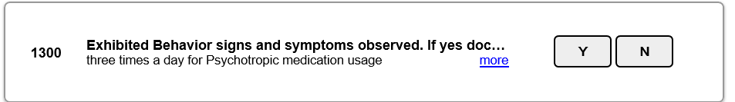
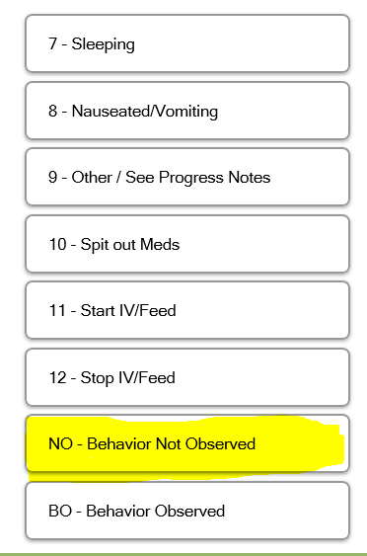
Behavior Note in PCC
Make when in EMAR to click the brick, not Y or N
If no behaviors click
NO-Behaviors observed then
record

Slide 94
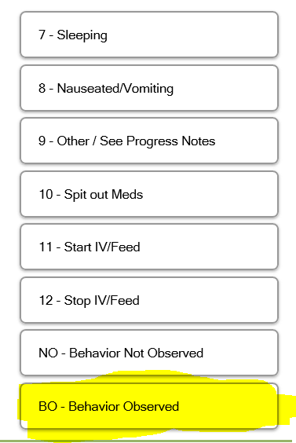
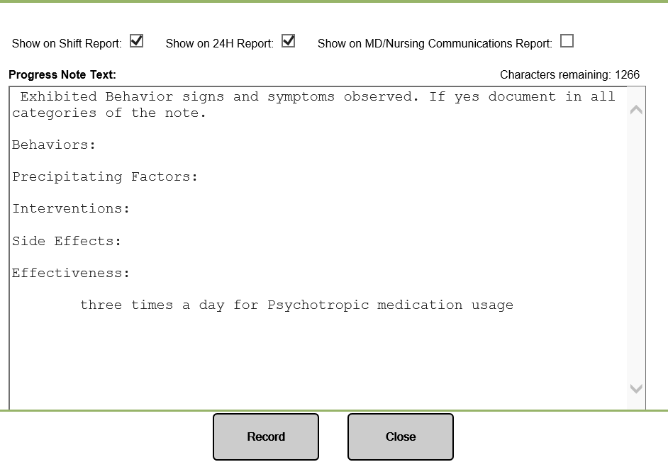
If behaviors are observed, click behaviors observed and document note accordingly and record.
Make sure to fill in note in its entirety so we can monitor for trends, and if need for different interventions for behaviors.

Slide 95
Diabetes impact on Elderly population
Higher rates premature death
Functional disability
Coexisting illnesses
Depression
Cognitive Impairment
Falls with injury
Persistent pain
Delayed healing
Infection
ADA Standards of Medical Care in Diabetes – 2019 Diabetes Care Volume 42 (1) https:://www.cdc.gov/diabetes/home
Poor muscle quality
Accelerated muscle loss
Institutionalization
Alzheimer’s type and multi-infarct dementia
Peripheral neuropathy
Visual impairment
MI
Amputation

Slide 96
Symptoms of Hyperglycemia/Hypoglycemia
Hypoglycemia
Hyperglycemia
BLOOD GLUCOSE UNDER 70 MG/DL
MILD/EARLY SYMPTOMS:
  Shakiness, cold clammy skin; diaphoresis,
  Palpitations; hunger; anxiety; tachycardia, nausea
MODERATE SYMPTOMS:
  Headache; tiredness/weakness; visual changes
  Slurred speech; paresthesia of mouth;⬇coordination; mental dullness
SEVERE REACTIONS:
  Behavior changes; seizures, confusion; coma; death
  Blood glucose elevated over 200 mg/dL
  Tiredness, increased urination (incontinence), excessive thirst, blurred vision, delayed healing, infections, weight loss, new or increased confusion

Slide 97
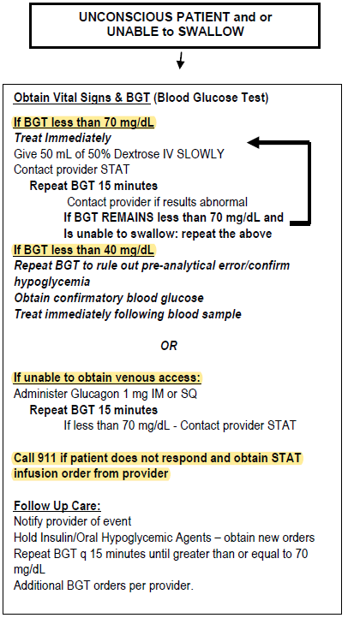
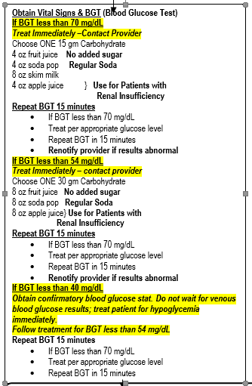
Hypoglycemic Protocol

Slide 98
Insulin Safety
All insulins need to have TWO nurses verify the type of insulin and dose and document in the eMAR
Insulin pens:
  single patient use- they are NOT to be shared,
  drawn off for another patient to receive their dose of insulin
  Safety needle must be used

Slide 99
Cardiopulmonary Resuscitation CPR
Initiated on all patients/residents without a DNR or without an identified Advanced Directive indicating “Do Not Resuscitate”
All licensed nursing staff and therapy staff are required to obtain and maintain CPR certification

Slide 100
Cardiopulmonary Resuscitation CPR
Identification
Blue Band – no DNR or other advance directive. Full Code
White Band – has a DNR or other advance directive indicating no CPR
Green Band – specific to Mercy Nursing Facility at OLV, has a DNR or other advance directive indicating no CPR
Notes:
“Band of blue, I’ll perform CPR on you”
“Band of white, go to the light”
“If I have a green sticker, don’t restart my ticker”

Slide 101
Occurrence Reporting
Purpose
To assure that appropriate and immediate interventions are completed to prevent the possibility of a re-occurrence.
To provide a factual record of the occurrence so that care being given can be evaluated and adequate care standards are followed.
To provide a factual record of the occurrence

Slide 102
Definition of an Occurrence
A situation that is not consistent with the acceptable standard care of a resident/patient or a situation which occurs during the routine operation of the facility that has the potential or already has had an untoward effect on resident or patient.

Slide 103
Definition of a Fall
Unintentional change in position coming to the rest on the ground, floor, or onto the next lower surface. May be witnessed, reported by the resident/patient or observer or identified when a resident/patient is found on the floor or ground, includes an intercepted fall in which the resident/patient would have fallen if they had not been caught by another person (lowered to the floor).

Slide 104
Procedure
Any occurrence with significant injury and/or harm; (Definition of Significant Injury: bone fractures, joint dislocation, closed head injuries with altered consciousness and subdural hematoma) requires immediate notification of the resident’s/patient’s attending physician as well as the DON and administrator by the end of the shift.
DON is also notified if the occurrence resulted due to failure to follow the care plan
All occurrences require notification of the resident’s/patient’s family or responsible party unless the designee/health care agent/responsible party has stated that they do not wish to be notified OR the resident/patient prefers family not to be notified. This will be documented in the resident’s/ patient’s medical record.

Slide 105
Procedure cont.
No reference to completing and Occurrence Report is made in the Medical Record.
The comprehensive care plan and kardex (as appropriate) will be updated immediately to reduce the risk of a repeat occurrence and the changes are communicated to the staff.
The patient/resident will be assessed each shift for a minimum 24 hours and documentation of the patient’s/resident’s status is documented on the occurrence report and in a nursing note.

Slide 106
Occurrence Reporting
All patients/residents who have a fall must be evaluated by therapy services
If the patient/resident is on anticoagulant therapy and there is an actual or suspected head injury, the physician must be notified and mention that is on anticoagulant therapy
Neuro checks will be performed with all falls that are unwitnessed or resident hit their head
  Q 15mins. X 4
  Q 30 mins. X 2
  Q 4hrs. X 24hrs.

Slide 107
Controlled Substances
Unit Security
A separate double locked cabinet for controlled substances will be located on each unit.
Controlled substances can be removed and placed in the double locked drawer in medication carts for the medication pass and then replaced back in the double locked cabinet afterwards
The keys to the locked narcotic cabinet will remain with the designated licensed nurse and must be held in their possession and not given to others

Slide 108
Things to remember regarding controlled substances
Controlled substances are to be double locked at all times.
Always sign the medication out on descending inventory log with the time removed from the blister pack, proceed to the patient/resident to administer. Sign out in eMAR immediately watching the medication be consumed.
When wasting a narcotic it is disposed of in the RX destroyer containers on the unit. A notation is made on and the descending inventory controlled substance sheet, both nurses initial the the inventory sheet.
Discontinued Narcotics are not to be destroyed on the unit, there is a special process to do a Narcotic destruction- these are locked in a double locked cabinet and counted shift to shift until collected by the designated persons

Slide 109
Infection Control for Long Term Care
In long term care facilities a common illness like a cold can be deadly to our elders.
It is our responsibility as care workers to ensure that we limit the spread of illness by applying strong infection control practices.
Hand Washing is number one defense for decreasing the spread of germs

Slide 110
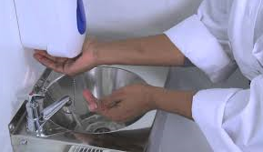
Hand hygiene is the most important step in the prevention of illness.
Always To be sure your hands are completely clean always use warm running water, and at least a dime sized amount of soap.
Rub all surfaces of the hands together for at least 20 seconds then rinse holding your hands in a downward position.
After rinsing, dry your hands, then use a new paper towel turn off the faucets of the sink.

Slide 111

Alcohol Based Hand Rubs- only when hands are not visibly dirty
When decontaminating hands with an alcohol-based hand rub, apply the product to palm of one hand, rub hands together, covering all surfaces of hands and fingers, until hands are dry. When decontaminating hands with an alcohol-based hand wipe, wipe both hands covering all surfaces of hands and fingers, and finger nails
Use hand rub for at least 20 seconds

Slide 112
When you need to hand hygiene
Here are some key moments to wash your hands during your work day:
  Before touching a patient/resident
  Prior to a clean procedure
  After body fluid exposure risk
  After touching a patient/resident
  After touching a patient/residents surroundings
  Anytime you change your gloves
Encourage your patient/resident’s to wash their hands as well
  After using the bathroom
  With AM/HS care
  Before and After meals
  When attending an off unit activity like therapy or church.
  Whenever they are soiled or there’s a possibility of them spreading infection to others.

Slide 113
Incontinence Care is another activity when strong infection control practices are essential.
Always wash your hands before and after, and wear gloves through out.
Change gloves when going from dirty to clean
Use a water proof barrier like a plastic bag or an incontinence pad to place the soiled items on to protect the other bed linens from being soiled. NEVER throw soiled items on the floor, even with a barrier.
Always cleanse the perineum with a clean area on the washcloth for each cleansing stroke, using a front to back motion to ensure no bacteria is introduced into the urinary tract. Follow the same method for rinsing.
Only apply barrier ointment with clean gloves to avoid re-introducing bacteria.
Remove gloves and wash hands before leaving the room, carry the soiled item to the dirty utility room immediately using your barrier to transport it.

Slide 114
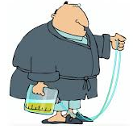
Infection Control with urinary catheters
Patient/Resident’s with urinary catheters are at a much higher risk for an infection than those without.
Complete catheter care at minimum Qshift, if build up is noted at the entrance to the patient/resident and whenever the patient/resident is incontinent of bowel.
Remove any secretions or build up from the catheter where it enters the body.
Use a warm soapy wash cloth to cleanse the catheter using a circular motion working from the urinary meatus down the catheter at least 3-4 inches. Rinse the tubing and dry using the same method.
Cover the urinary drainage bag with a privacy cover to promote dignity and reduce the spread of infection.
Urinary drainage bags should be always below the bladder and not touch the floor

Slide 115
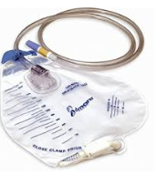
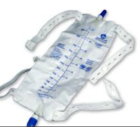
Always wear gloves while handling the catheter, the drainage tubing or the drainage bag.
Cleanse the ports of the leg bag or gravity drainage bag with an alcohol swab when disconnecting/reconnecting the tubing.

Slide 116
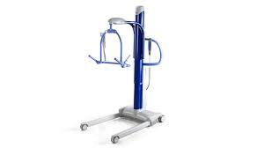
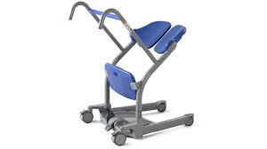
Cleansing of shared medical and other devices is an essential step in our infection control program. Below is a list of items that should be cleaned before and after use
    Mechanical Lifts, standing frame, Sara steady
    Walkers, canes, wheelchairs
    Shower Chair
    Vitals Machine
    Commode, raised toilet seats
    TV remotes, call lights
    Over bed tables

Slide 117
If you have questions while you are at one of our facilities please ask for clarification and access to our policies.
Thank you and we hope you enjoy your clinical experience
at Catholic Health
THE END!

