Slide 1



01/12/2021 Clinical Education

Slide 2
Welcome To Catholic Health
Please review this information; take the time to read each slide as it contains information relevant to your practice at Catholic Health
Registered Nurses are expected to practice within Catholic Health Policy and Procedures at all times

Slide 3
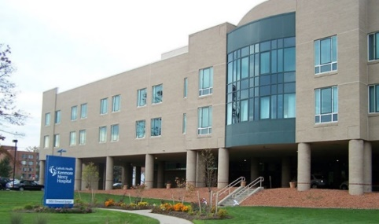

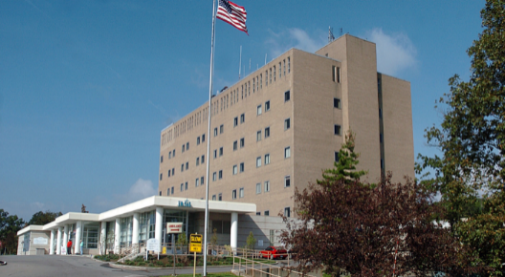

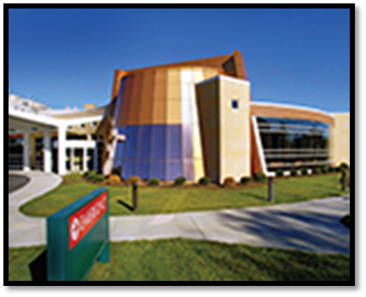
Welcome to Catholic Health
Kenmore Mercy Hospital
Mercy Hospital of Buffalo
Mount Saint Mary’s Hospital
Main Street Campus
St. Joseph’s Campus
Sisters of Charity Hospital
2 Campuses
Notes:
When clicked on picture, opens up slides 3-6 per site.
-Slide 3, 4, 5 : Kenmore
-Slide 6, 7, 8: Mercy
-Slide

Slide 4

CH Dress & Appearance
Hair should be neat and back during patient care
Footwear must be clean and in good repair
Clinical personnel must wear socks or hosiery
Clothing must be clean and properly fitted
Proper undergarments are to be worn
Denim, printed tee shirts, spandex, shorts, and bare midriffs are NOT acceptable

Slide 5

Providing Excellent Care
At anytime you encounter a situation where you are unfamiliar with a situation, procedure or equipment, it is your responsibility to seek out the appropriate resources before proceeding
Know where to find your resources

Slide 6
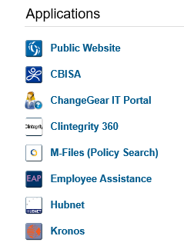
Locating a CH Policy-M-Files
Catholic Health provides many resources
M Files is where all policies and procedures are located on the Catholic Health Intranet

Slide 7

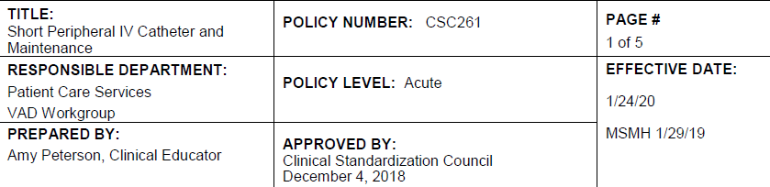
Locating a CH Policy
When looking for a policy-make sure it is for the area you are working in. CH policy has divisions like Homecare/CBC/Acute Care

Slide 8
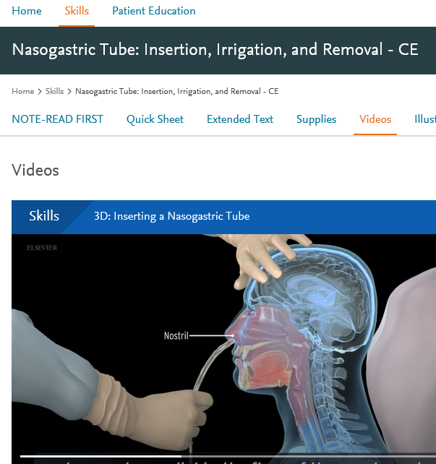
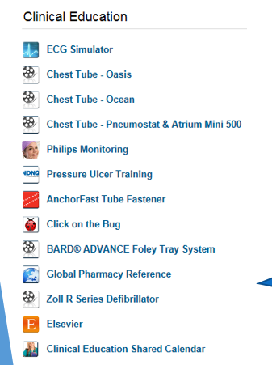
I Never Have Done That???
Watch the Elsevier Video!!

Slide 9
Elsevier Provides Educational Resources
If you see NOTE-READ FIRST on the Elsevier page, it means there is a slight variation from CHS policy.
Look up the policy before proceeding

Slide 10
Elsevier
Not Sure What Supplies You Need for a procedure ?
Look Here
Quick Sheets and Extended Text. Support at your finger tips. These can be printed for you to reference.

Slide 11
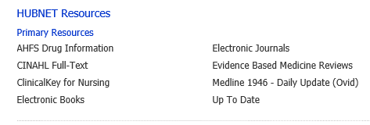
HUBNET located on the CH Intranet Provides Many Clinical Resources
Up to Date provides everything you need to know about clinical conditions. Never heard of mitochondrial disease?? Look on Up To Date

Slide 12

Documentation
All documentation will occur in the electronic health record
The Registered Nurse is responsible for accurate and timely documentation using the EPIC system
HIPAA protection must be maintained at all times

Slide 13
Patient Bill of Rights
Please review the link below
https://www.chsbuffalo.org/about-us/compliance-program/patients-bill-rights

Slide 14
Catholic Health
Nursing Standard of Care
Located on M Files are Standards of Care for clinical areas
They provide a framework for job expectations
It states the RN shall provide quality care by doing:
Assessment of patients
Implementation of orders
Evaluation of patients
Documentation of care provided
Notifications to provider
Search STANDARD of CARE in M FILES
You might want to print that one to review!

Slide 15
Occurrence Reporting
Occurrences are events that are unplanned, unexpected and unrelated to the natural course of a patient’s disease process or routine care and treatment
Occurrences can happen in any department
Any associate who discovers, witnesses or to whom an occurrence is reported is responsible for documenting the event immediately via the Occurrence Report located on the CHS Intranet
Do not document that an occurrence report was completed or give your opinion in the medical record or on the occurrence report

Slide 16


Purposeful Rounding
Improving patient safety
More than a quick glance
Improving patient outcomes
Evidence based proactive strategy
Improving patient satisfaction
More than a checkmark on a whiteboard
Efficiency of care
Helps manage our work
What is it?
Notes:
Mike – I have used animations on this slide to match the voice over.
1st fade: “What is it?”
2nd fade: picture
3rd fade: the blue hexagons

Slide 17
Purposeful Rounding
Every hour
What is it?
Pain
Position
Personal Hygiene
Possessions
Notes:
Mike – I have used animations on this slide to match the voice over.
1st fade: Pain
2nd fade: Position
3rd fade: Personal hygiene
4th fade: Possesions

Slide 18
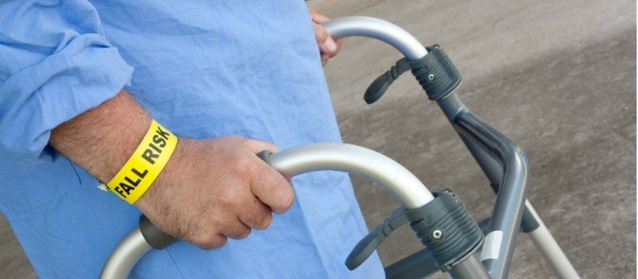

Purposeful Rounding
Why?
Our patients benefit from it…
Decreased patient falls by over 50%
Decreased skin breakdown by 14%
Increased patient satisfaction by 10%
Improved pain management
Notes:
Mike – I have used animations on this slide to match the voice over.
1st fade: “Why?”
2nd fade: “Our patients benefit from it….”
3rd fade: the bulleted texts and the 2 pictures

Slide 19

Purposeful Rounding
Why?
We benefit from it…
Decreased call lights by 40%
Improved efficiency of care, saving nurses 166 hours per month
Reduction of the amount of walking by 20%
Notes:
Mike – I have used animations on this slide to match the voice over.
1st fade: “We benefit from it…”
2nd fade: the bulleted texts and the picture

Slide 20
Purposeful Rounding
“Hi (Patient’s name) my name is and I will be your nurse/attendant today. I want to explain a process we perform at (Hospital Site). Because we want you to receive the best care possible, we are going to round on you every hour while you are here. We want to anticipate your needs, so when we round you can expect that we will ask about your pain, your comfort, if you need to use the restroom, and if you have everything you need. We also will be updating your communication board throughout the day.”

Slide 21
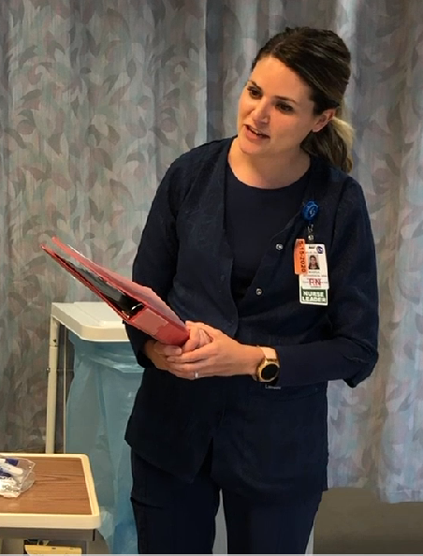
Purposeful Rounding
“Hi Mr. Smith I am here to do my hourly rounding.”
Pain – “How is your pain right now?”
Position – “Are you comfortable? Would you like me to help you get repositioned?”
Personal Hygiene – “While I am here, let’s try going to the bathroom”
Possessions – “Is there anything I can move closer to you so that you can reach it?”

Slide 22
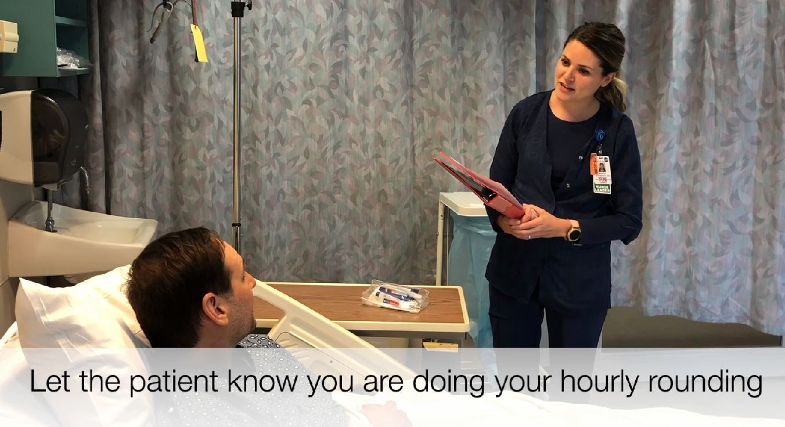
Purposeful Rounding
“Is there anything else I can do for you while I’m here? I have the time.”
“I will be back in to check on you in an hour. Here is your call button if you need something before then.”

Slide 23

Patient Complaint Process
When a patient, family member or representative complains it should be reviewed and resolved immediately.
If unresolved, a written complaint form (found in M-Files) should be completed by the supervisor or patient representative.
A patient representative will review the complaint and initiate follow-up.
Any situation involving lost personal property, refer to Occurrence Reporting Policy

Slide 24

Visiting Restrictions Process
Two visitors restricted per patient in a semi-private room
Three visitors per patient in a private room
Patients going to surgery may have immediate family members visit throughout the day of surgery
When necessary, one person may remain with the patient after routine hours and at night with permission of manager or administrative nursing supervisor
The following days, children may visit without special permission:
    New Year’s Day, Easter, Mothers Day, Fathers Day, Thanksgiving, Christmas

Slide 25

National Patient Safety Goals
The Joint Commission Standards
Acute Care Hospitals

Slide 26
The Joint Commission National Safety Patient Top Goals
Identify patients correctly
Improve staff communication
Use medication safely
Use alarm safety
Prevent Infection
Identify patient safety risks
Prevent mistakes in surgery

Slide 27

Why Are These Goals Important?
The safety goals listed often come from incidents or sentinel events related to patient harm
Sometimes preventable incidents!
We must work as a profession to ensure the safety of our patients

Slide 28
Catholic Health Policy
Catholic Health has policies to support your practice for each identified National Patient Safety Goal
Policies are created to standardize our care and protect our patients
You are expected to practice within the policy at all times

Slide 29

GOAL: Improve the Accuracy of Patient Identification
CHS-QPS-003

Slide 30

GOAL: Improve the Accuracy of Patient Identification
Wrong patient errors occur in virtually all stages of diagnosis and treatment
The intent for this goal is two fold
#1. To reliably identify the individual as the person for whom the service or treatment is intended
#2. Match the service or treatment to that individual

Slide 31

GOAL: Improve the Accuracy of Patient Identification
Emergency Department staff will verify patient identity using patient name and date of birth and and place a blue armband while in the ED
Prior to being admitted/transported to the nursing unit, they will change the band to a white ID band

Slide 32
GOAL: Improve the Accuracy of Patient Identification
Nursing staff receiving the patient will check patient’s name and date of birth on white armband for validity and ascertain that the blue armband has been removed
Admitted Patient

Slide 33
Goal: Identify patients correctly
Use at least two ways to identify patients
NAME & DATE of BIRTH
This is done to make sure that each patient gets the correct medicine and treatment
Make sure that the correct patient gets the correct blood when they get a blood transfusion

Slide 34
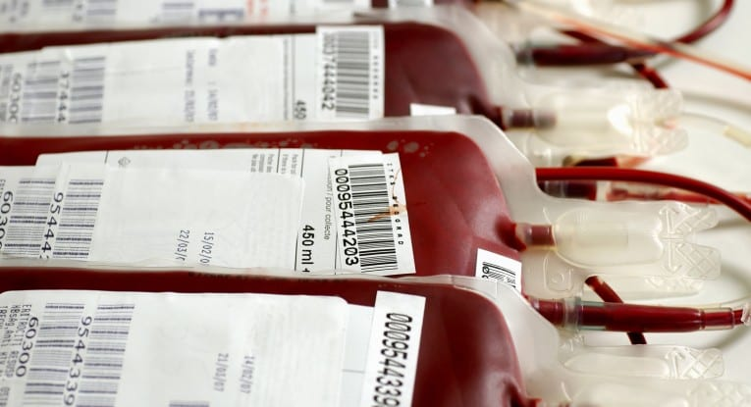
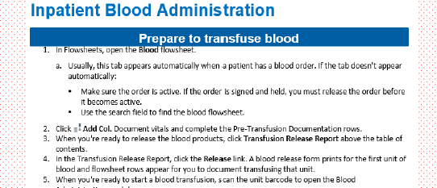
GOAL: Eliminate Transfusion Errors Related to Blood Transfusion
Make sure that the correct patient gets the correct blood when the get a blood transfusion
Look up the blood transfusion policy on M Files
2. Use the EPIC transfusion guide. This is a reference at your fingertips at your wheelie
Notes:
Read the policy prior to your first blood transfusion
Watch the Elsevier video
Follow EPIC process for blood administration

Slide 35

Patient ID Checks
Any Time You are in Contact with a Patient
Arrival on unit
Consent
Arm band placed
Charting
Breast milk
Patient meals
Prior to procedure
Blood draws
Transfusion
Phone/Verbal order
Med administration
Assessment
Transport of patient

Slide 36

Allergy ID for Patients
Noted on Admission and Documented by RN
Red ID Band indicates Any Allergy
Green ID Band indicates Latex Allergy
Sticker is placed on patient’s chart & noted in EMR also
Don’t forget to list if allergies are both Food and Drug allergies (i.e.. Eggs, Pork)
Notes:
Green- Latex Red- Allergy present

Slide 37

Name Alerts
Always be on the lookout for name alerts
Patients may have the same name or similar sounding names
Remember 2 person identifier-name and date of birth

Slide 38

GOAL: Improve the Effectiveness of Communication Among Caregivers
Critical Values (Results) CHS-QPS-016

Slide 39
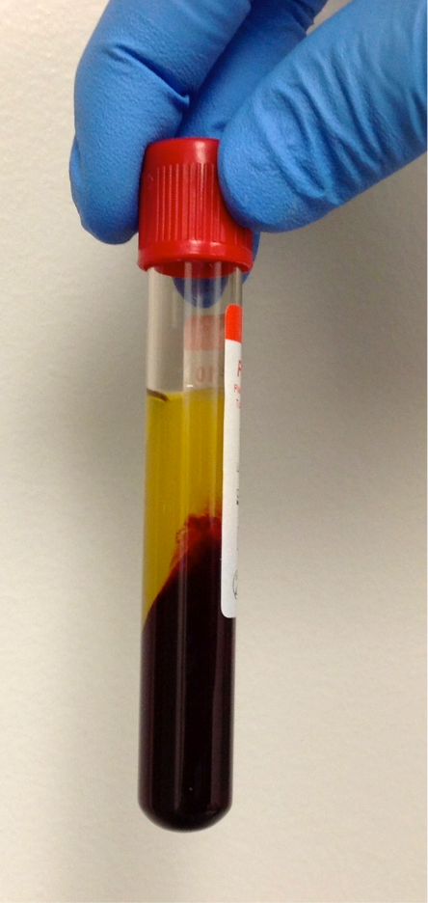
GOAL: Improve the Effectiveness of Communication Among Caregivers
Critical results that fall significantly outside the normal range and may indicate a life threatening situation
Report Critical results of tests and diagnostic procedures on a timely basis
Critical Values (Results) CHS-QPS-016
Notes:
Pull up the policy

Slide 40
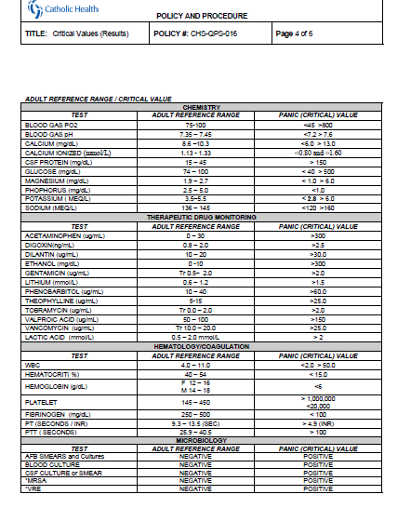
GOAL: Improve the Effectiveness of Communication Among Caregivers
Critical Value
Test value that if not acted upon, may result in the patient being compromised medically
The Provider
Should return your call within 60 minute time frame
You should have orders or intervention by 60 minutes
Read the Critical Values Policy
A critical Value or Result??
Get a response

Slide 41
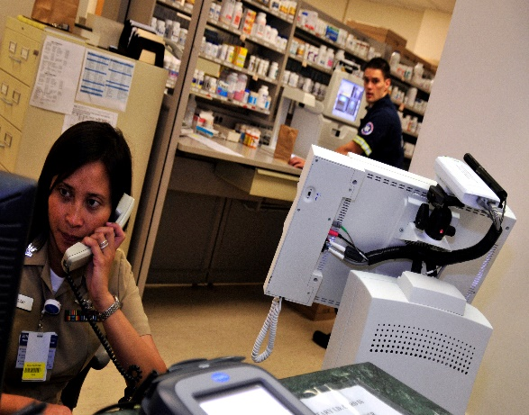
Improving Communication
SBAR Be Prepared
S – situation
  Reason for call, vital signs, concerns
B – background
  Mental status, skin, oxygen status
A – assessment
  What you think the problem may be, unstable, lab values
R – recommendation
  Would you like any tests ordered, how often do you want vital signs, what should be done if patient status does not improve

Slide 42
Critical Value = Abnormal Result
Lab (Serum) Critical Values
Potassium (< 2.8, > 6.0)
Sodium (< 120, > 160)
Hct (< 15)
Hgb (< 6)
Glucose (< 40, > 500)
Magnesium (< 1.0, > 6.0)
WC (< 2.0, > 50)
Lactic Acid (> 2)
Ask if you aren’t sure about a Critical Value

Slide 43
Critical Value = Abnormal Result
Radiology
Intracranial Bleed
Pulmonary Embolism
Pneumothorax
Abdominal free air
Ruptured Aneurysm
Unstable Spinal Fracture
Retained Foreign body
Stress Testing
Complication/Admission
Abnormal w/Poor Prognosis
Sustained Dysrhythmia

Slide 44

Cardiology Critical Values
On EKG Holter Monitor
Acute, recent or possible MI SVT/VT > 30 seconds
Current Injury CHB
Bradycardia with HR ↓40 Sinus Pause > 3 seconds
Tachycardia with HR ↑ 150
2nd degree Type II Block
Complete Heart Block (CHB)
Ventricular Tachycardia
Electrical Alternans

Slide 45
Critical Values or Results
If a provider does not call back within 30 minutes
Make the call again
Document time, whom you’ve spoke to and response (if any)
Notes:
.
1st fade: If a physician does not call back within 30 mins
2nd fade: Return the call again

Slide 46
Medical Chain of Command
If a provider does not call back within an additional 30 minutes (60 mins in total)
Inform the charge nurse or supervisor
Contact the Hospitalist or Resident if required immediate assistance

Slide 47
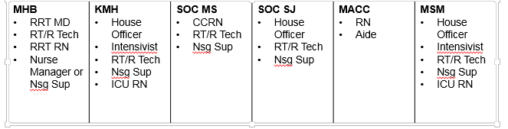
Rapid Response Team
Patient Significant Change in Condition
Look who will come to your bedside for a rapid response
Decisions may me made
Fluid resuscitation, other interventions are done
Code Stroke is called by RRT once they have seen patient

Slide 48
Number for Rapid Response
CALL 5 5 5 5 5

Slide 49
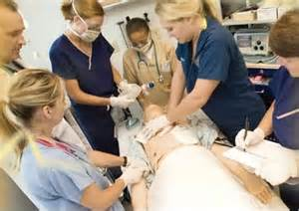
Call a Rapid Response for
Significant Change in Patient Condition
Vital signs: HR, BP, RR, Cardiac rhythm
Breathing/airway decline, ↓O2%
Acute bleed – Severe bleed
Unresolved chest pain
Pt. not responsive to treatment
Signs or symptoms of Stroke
New Onset Neuro decline
Change in LOC or MS
Patient/Family concern

Slide 50
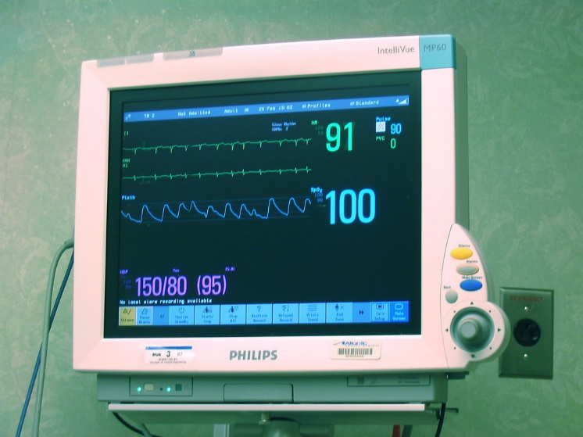
Significant Event Timing
Time notation is critical when recording
  Patient condition changes
  Emergency meds given
Use for notation
  1^{st -} Computer screen
  2^{nd -} Phone display
  3^{rd -} Cell phone
  Absolutely Last - Wall clock

Slide 51
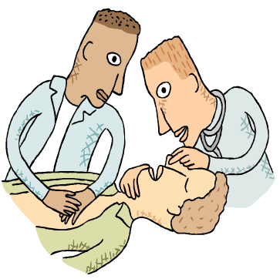
Rapid Response/Significant Change
RN Role
The Nurse responsible for the patient should
Remain at bedside - have EMR available
SBAR ready for the RR Team
Assist as needed with Rapid Response needs
Communicate with family/surrogate

Slide 52

Bedside Reporting is Expected
Bedside Reporting is done at the beginning of the shift
Bedside Reporting includes the patient and/or their family
This gives you the opportunity to assess the patient with the next shift nurse to make sure that your patient is comfortable and does not have any questions regarding their care thus far
CHS-QPS-015 Effective Communication-Hand Off

Slide 53
Why Do Bedside Report?
When you give or receive bedside report, you have the opportunity to look at the patient, inspect IV fluids, IV or central line sites
You see how the patient looks and is acting
The patient sees you and hears that you know them and you are making sure that the next RN will continue to provide the same level of care

Slide 54
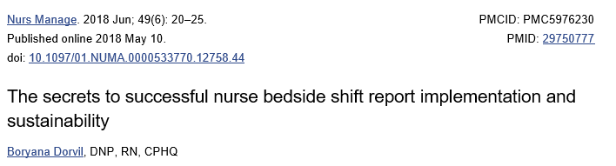
Why Do Bedside Report?
Bedside report is part of nursing best- practice guidelines
It allows us to confidently hand off our patients in the best condition possible
Plenty of Evidence to support this

Slide 55
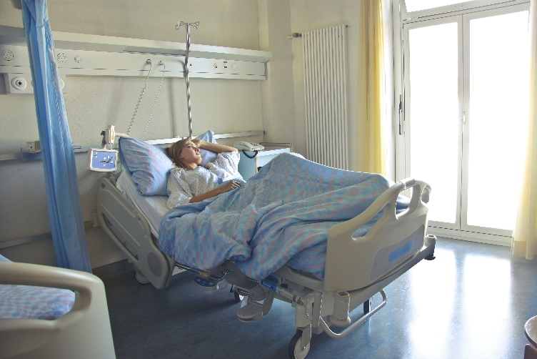
Why Do Bedside Report?
Patients report improved satisfaction when bedside reporting is the standard
When I hear you give report, I feel confident about my care

Slide 56

Isn't Bedside Report a HIPAA Violation?
No it is not
Don’t share confidential information during bedside report, wait for a private space for that
Looking at the patient and setting the plan of care is not confidential

Slide 57
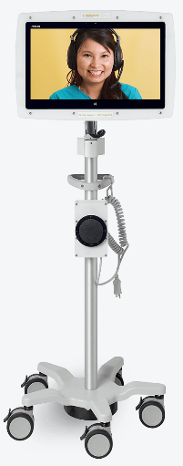
Language Assistance Program
Alternative Means for Communication Must Be Provided to Those in Need !
Interpreter services are available to CH patients, free of charge, 24/7
Video display monitors (VRI), are located throughout each acute hospital site. To locate, please contact your facility patient representative for availability
In Demand Interpreting Phone # 1-877-899-3824
Policy #CHS-CCP-121A - Communication Assistance for Limited English Proficient (LEP) Persons, Hard of Hearing and Visually Impaired Patients
Notes:
Mike – can we link that policy (# CHS-CCP121A) ?

Slide 58
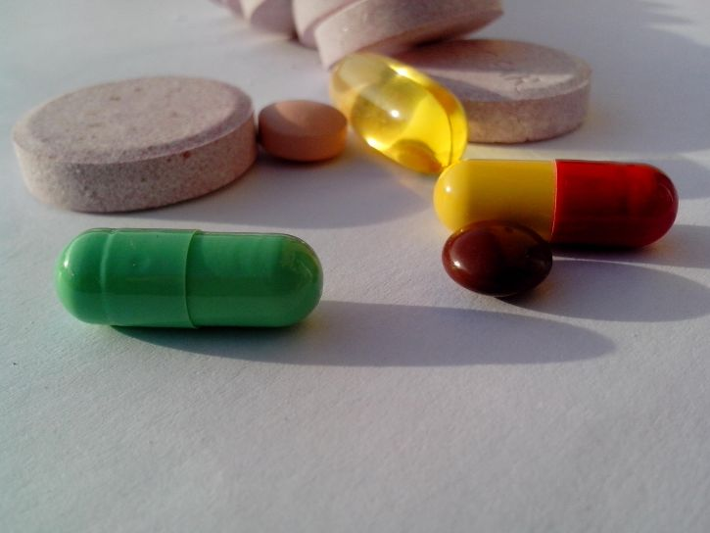
GOAL: Improve the Safety of Using Medications

Slide 59
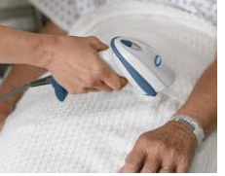
GOAL: Improve the Safety of Using Medications
Right Person
Right Medication
Right Dose
Right Route
Right Time
Right Documentation
Use scanning technology at all times

Slide 60
GOAL: Improve the Safety of Using Medications
Labeling Med container
Name, dose, route for drug
Patient specific
Must have patient name & DOB
Labeling must occur
When medication or solution is taken out of it’s original packaging
Placed into a different container

Slide 61
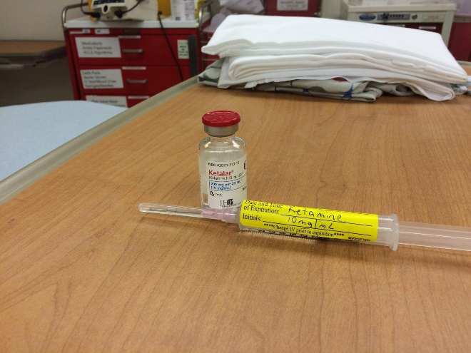
GOAL: Improve the Safety of Using Medications
All Must be Labeled
Medications
Med containers
  Syringes
  Medication cups
  Basins
Solutions

Slide 62
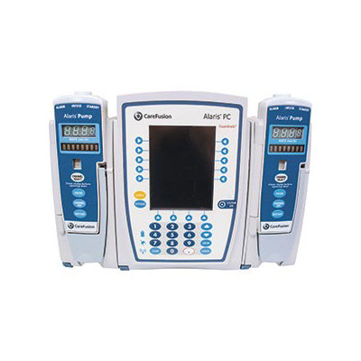
Alaris Guardrails for ALL Medications
All IV solutions and IV medication drips must always be on Guardrails Infusion, never use Basic Infusion
Each medication is set to a “hard max”
If a drug needs to exceed the hard max and run off Guardrails, pharmacy must be notified to verify the dose

Slide 63
Goal : Reduce the Likelihood of Patient Harm
Anticoagulation Therapy
Adult Heparin
Weight Based Protocol

Slide 64
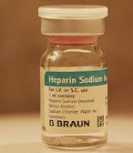
Anticoagulants are more likely to cause harm due to complex dosing, insufficient monitoring, and inconsistent patient compliance

Slide 65

EPIC Learning Home Dashboard
Located on the EPIC Learning Dashboard is a very important resource for navigation in EPIC and contains many Tip Sheets
This is very helpful for heparin protocol navigation

Slide 66
Very Important
IV Heparin Safety
Heparin therapy requires vigilance and attention to detail, every time, every patient
Take the time to review the chart, the patient weight and the provider order
2 RN check is mandatory when initiating and adjusting dose at all times
Follow all safety processes, utilize references available on M Files and within EPIC

Slide 67
Very Important
IV Heparin Safety
Heparin Protocol dosing in EPIC & Infusion via the Alaris Pump should always be done using
Units/kg/Hour
Program the Alaris pump to the patient weight that is in the initial order
Input the patient dose in the pump always as units/kg/hr
Draw an antiXa level 6 hours after initiating heparin therapy and review the results

Slide 68
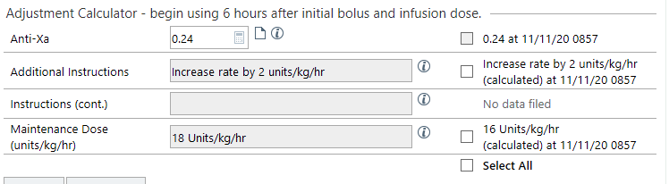
Very Important
IV Heparin Safety
Heparin is weight based for the low and high dose therapies
It is not adjusted by MLs!!!
Adjusting the drip will be by changing the units!

Slide 69
Administer Medications Safely
Medication Reconciliation Policy
Before a procedure, label medicine that are not labeled
Record and pass along correct information about a patients medicine
Find out what medicines the patient is taking
Compare those medicines to new medicines given to the patient
Medication Reconciliation QPS-005
Notes:
Medication Reconciliation QPS-005

Slide 70

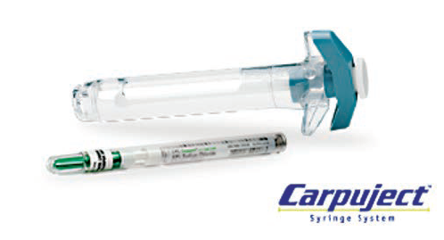
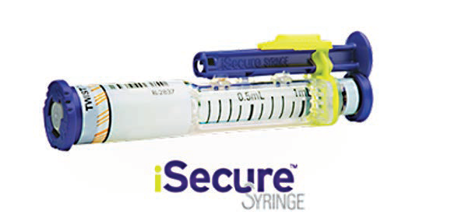
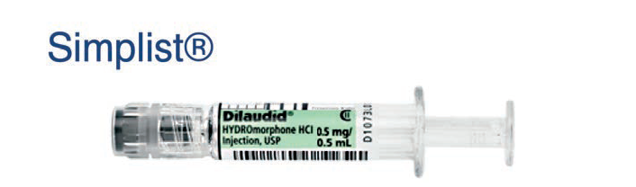

Slide 71
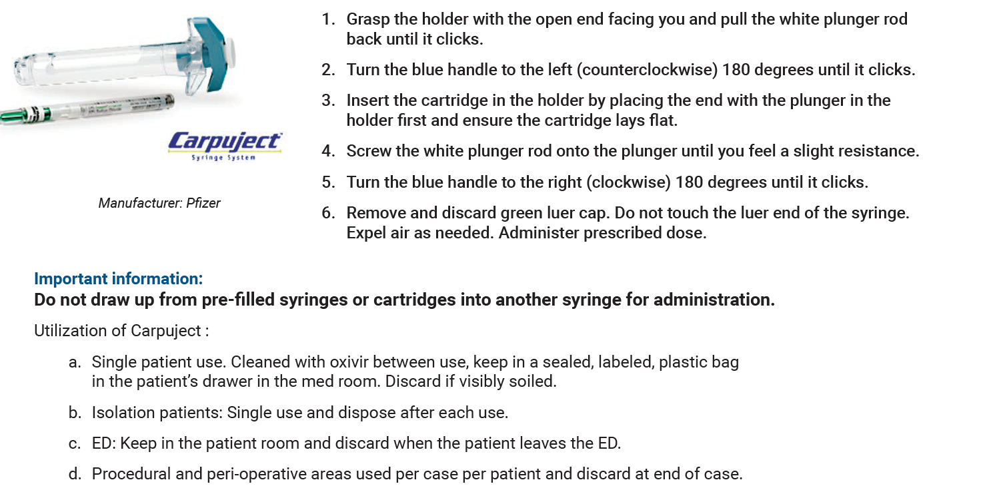

Slide 72
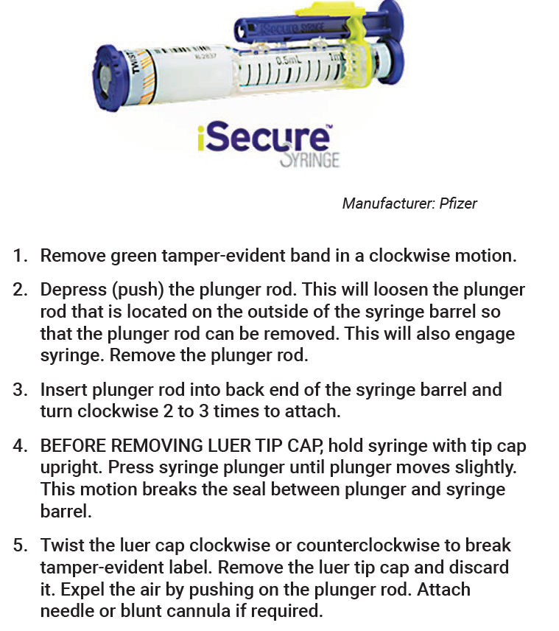

Slide 73
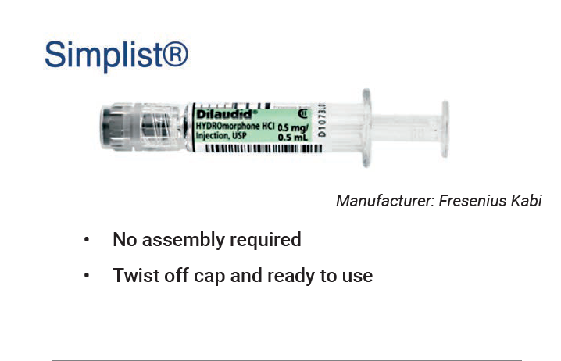

Slide 74
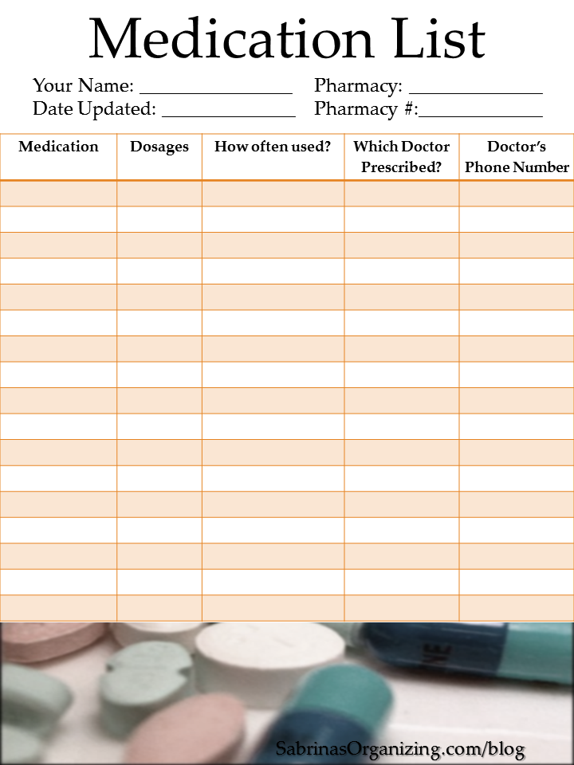
Maintain and Communicate Accurate Patient Medication Information
Make sure sure the patient knows which medicines to take when they are at home
Tell the patient it is important to bring their up-to-date list of medicines every time they visit a doctor

Slide 75
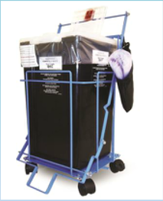
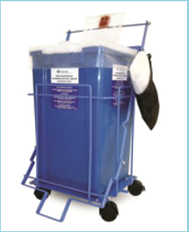
Pharmaceutical Waste Program
Various waste bins are located on the units that are designated for specific medications to be discarded into
Specific coding or messages on hazardous medications can determine which waste bins must be used for discarding (per pharmacy)
Dispose Meds Properly

Slide 76

Pharmaceutical Waste Program
Controlled substances:
  Full and partial doses must be destroyed in the patient care area
  Must be destroyed by one RN and witnessed by another RN

Slide 77
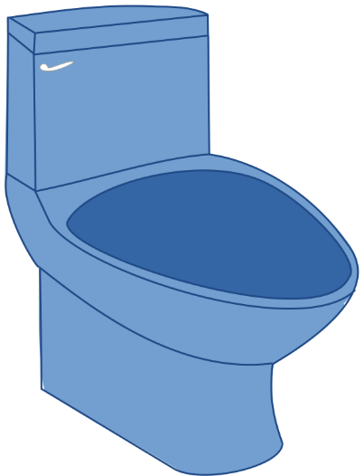
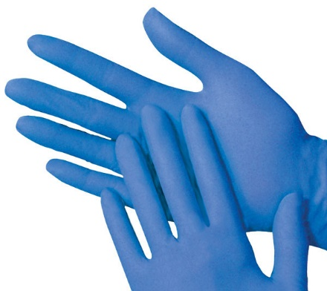
Pharmaceutical Waste Program
  Must wear protective gloves when handling
  Placement and removal of Transdermal patches must be documented every shift
    Fold patch in half and flush down the toilet
    Destruction of the patches must be witnessed and documented by 2 RNs

Slide 78
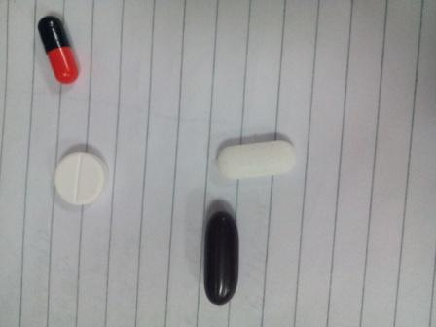
Pyxis Machine – 2nd RN Witness
Controlled Substance Removal
Pyxis machines require nurse verification of count listed on screen
Nurse to do a physical count of remaining medication
If count is incorrect Pyxis will alert the RN to correct !!!!
2nd Nurse witness for any medication returned to Pyxis is mandatory
Notes:
Policy change released June 2017 Policy Update

Slide 79

FYI-Information from
Pharmacy and Nursing Leadership
Daily & Monthly
Narcotic reports are being monitored and discussed together
Daily
Pharmacy runs reports to monitor internal pharmacy department controls and additional reports to monitor Pyxis MedStation activity
Override reports – verifying that any med pulled on override has a corresponding physician order
On Demand
Investigation of suspicious activity via Pyxis or MAK

Slide 80
Information from
Pharmacy and Nursing Leadership
Monthly
Pharmacy IT runs diversion reports for each site and posts them on the S drive for Pharmacy & Nursing to monitor & examine together. Examples include:
Reports are run for float & agency nurse activity
Diversion Watch List – reviews each user (pharmacy and nursing) in 5 categories of controlled substance (CS) activity & ranks them against their peers
Cancelled Transactions
CS doses Dispensed, Discrepancies and Waste Activities

Slide 81
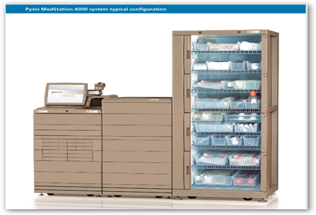
Pyxis – Reminder
Controlled Substance Removal
Pyxis machines require
Nurse verification of count listed on screen
AND
Nurse to do a physical count of remaining medication
If count is incorrect Pyxis will alert the RN to correct
Notes:
Policy change released June 2017 Policy Update

Slide 82
Reduce the Harm Associated With Clinical Alarm Systems
Cardiac Monitoring/ Telemetry CSC0102
Chair Alarms, bed alarms, and personal alarms CSC0036

Slide 83
Alarm Safety
Follow established policy guidelines for alarm settings on alarm equipped medical devices
Follow established policy guidelines for tailoring alarm settings and limits for individual patient
Respond to patient alarms timely and evaluate patient for change in condition
Assure the volume on alarms is audible to staff at all times

Slide 84
GOAL: Reduce the Harm Associated With Clinical Alarm Systems
Make improvements to ensure that alarms on medical equipment are heard and responded to on time
Prevent Alarm Fatigue
Prolonged alarms are a Patient Dissatisfier
Cardiac Monitoring/ Telemetry CSC0102
Chair Alarms, bed alarms, and personal alarms CSC0036
Notes:
Cardiac Monitoring/ Telemetry CSC0102
Chair Alarms, bed alarms, and personal alarms CSC0036

Slide 85
GOAL: Prevent Infection
Implement evidence-based practices to prevent healthcare-associated infections

Slide 86
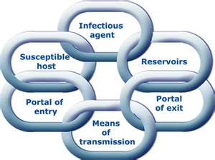
GOAL: Reduce the Risk of Health Care Associated Infections
A Healthcare Associated Infection-(HAI) is an infection that is a localized or systemic condition that was not present or incubating at the time of admission
Preventing HAIs requires the constant interaction of every department in the hospital. This includes nursing, clinical departments, quality, environmental services and administration.

Slide 87
GOAL: Reduce the Risk of Health Care Associated Infections
Infection Control performance improvement activities are intended to monitor, document, and improve the quality of Infection Control practice through ongoing surveillance
Preventing infection is the responsibility of everyone working at Catholic Health
Infections can put everyone at risk
Infections can be prevented if everyone is committed to doing their part

Slide 88
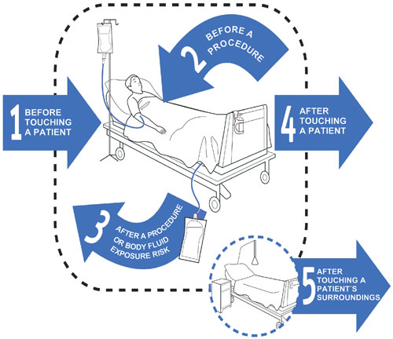
Hand Hygiene
Traditional Hand Washing
15-20 seconds using running water and soap
Use Waterless Hand Sanitizer
Artificial fingernails of any sort are not to be worn if you work in any clinical area

Slide 89
Reduce the Risk of Health Care Associated Infections
Use proven guidelines:
To prevent infections in the blood
To prevent infections after surgery
To prevent infections of the urinary tract caused by catheters
Using Bundles

Slide 90
Central Line Maintenance Bundle
Hand Hygiene
Maximal barriers for insertion
Aseptic technique
Assure Dressing is clean, dry and intact
Change suture-free securement device at the same time as the transparent dressing

Slide 91
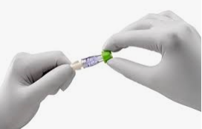
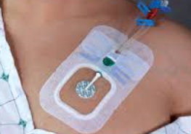
Central Line Maintenance Bundle
Use of Curos Caps for central lines
Scrub the Hub when indicated
Sterile dressing change every 7 days and as needed (if soiled)
Review with the provider if the central line is still needed

Slide 92
Catholic Health Infection Control Initiatives
Removing the Line When No Longer Needed
The need for daily intravascular access with a central line is assessed daily to determine if the line is still indicated and documented in the medical record
If not indicated, the central line is removed

Slide 93
Catholic Health Infection Control Initiatives
Tubing and Devices
Administration sets are changed at least every 96 hours
IV tubing and devices for TPN changed within 24 hours of starting the infusion

Slide 94
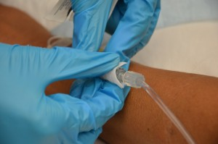
Catholic Health Infection Control Initiatives
Scrub the Hub
Catheter hubs, needleless connectors and injection ports are cleaned before accessing the catheter with chlorhexidine, 70% alcohol and a twisting motion used for at least 15 seconds

Slide 95
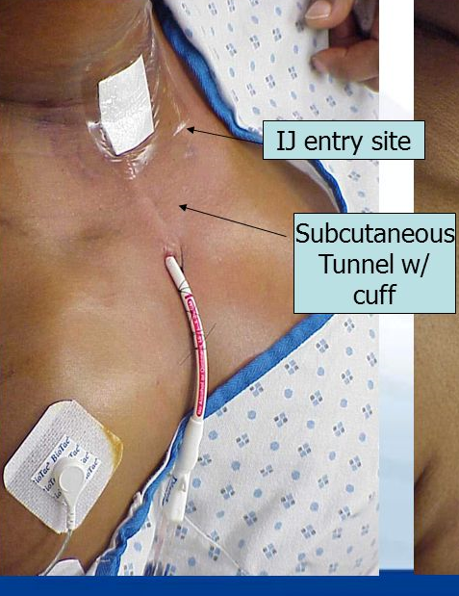


Know Your Lines So You Can Advocate For What’s Most Appropriate
Peripheral IV Lines
Short PIV
Ultrasound-guided PIV
Midline
Central IV Lines
PICC
Non-tunneled Central Venous Catheter
Tunneled Central Venous Catheter
Mediport
Femoral temporary and permanent)
Dialysis Catheters (
For details about the use and care of all these lines see the CBL:
Central Line Care & Maintenance

Slide 96
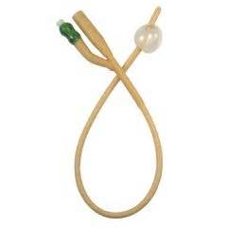
Urinary Catheter Bundle
CAUTI Prevention
Appropriate reason for placement
Hand Hygiene
Wear gloves
Strict Aseptic technique
Routine peri-care
Securement device used
Bag below bladder
No part of system to touch the floor

Slide 97
Acceptable Indications For A Urinary Catheter
Genitourinary Surgery/Urologic – Urology is following, had a genitourinary surgery ONLY. MD to order discontinuation.
Chronic – Neurogenic bladder, chronic at home. Replace if not functioning.
Perioperative – Covers pre-op, intra-op, and post-op. Must be discontinued within 24 to 48 hours post-op.
Acute Urinary Retention – 24-48 hours only. Voiding trial to take place after allotted time.
Hospice/Palliative – Limitations of treatments (no lab tests) in place.
Perineal Pressure Injury – Stage 3 or greater. Must be reordered every 5 days.
Strict I&O for Med/Surg or Critical Care- CC Foleys need to be reordered every 48 hours, M/S every 24 hours

Slide 98

Urinary Catheter Policy
CSC0017
Know the policy before you send a urine culture from a Foley

Slide 99
PROTOCOL FOR DIAGNOSIS OF CATHETER ASSOCIATED UTI
Bacteriuria/Candiduria without infection are common in patients with indwelling catheters. Do not test unless compatible signs and symptoms of UTI or if cause for fever is not compatible from other sources.
INITIAL SCREEN: Signs/symptoms compatible with CA-UTI
with no other identified source
NO
CA-UTI UNLIKELY
Do not send Urine Studies
Know Where to Find and Follow the Protocol
YES
CA-UTI UNLIKELY
No further Urine Studies. Avoid antibiotic therapy in absence of alternative indication
Send Urinalysis alone:
>10 WBC/hpf present?
NO
YES
NO
Send Urine Culture
Catheter ≥2 days old?
YES
Replace or Remove Catheter* then send repeat Urinalysis
>10 WBC/hpf present?
YES
Send Urine Culture
NO
CA-UTI UNLIKELY
No further Urine Studies. Avoid antibiotic therapy in absence of alternative indication
Urinary Catheter Policy
CSC0017
The above protocol is not intended for pregnant women, neutropenic patients or patients undergoing invasive urologic procedures.
* Replacement/Removal of catheter should not occur if there is concern that replacement may not be possible secondary to anatomical irregularities or a history of difficult Foley placement

Slide 100
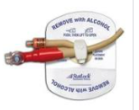
Urinary Catheter
Sampling and More
RNs
Only staff to obtain sampling from urinary catheters
Can apply/reapply Stat Lock devices
NAs
Should not obtain cultures or samples from catheters
Can apply/reapply Stat Lock device - except for both SOC sites (SOCH and St. Joseph’s) Nurse Aides

Slide 101

Urinary Catheter Policy
Pre-Catheter insertion assessment includes doing a Bladder Scan
Indications for Bladder scan include
Patient is uncomfortable (s/s retention), whether voiding or not
Patient has urge to void but is unable to do so
Patient verbalizes sensation of incomplete voiding with or without incontinence
Patient has not voided within 12 hours

Slide 102
Urinary Catheter Policy
If Bladder Scan shows→ 600-1000 ml
RN Will:
Notify provider, obtain order for
Straight Cath every 12 hours prn for bladder volume (600-1000) x 24 hours with inability to void
If Bladder Scan shows→ ˃ 1000 ml
RN Will:
Notify provider, obtain order for
Insertion of Urinary Catheter if provider deems catheter appropriate

Slide 103

Urinary Catheter Policy
2 Bladder Scans - Each with 600 - 1000 ml output
in a 24 hour time frame?
RN Will
Contact provider for further orders
Remember to record the urinary output in the patient’s chart/EMR when a bladder scan is done

Slide 104
Patient Bathing-Use of Chlorahexidine Gluconate Solution 4.0%
Policy PCS0007

Slide 105

CHG Bath Process
Initiation of CHG Bathing does not require an order by a provider, you are following a protocol
Patient’s allergies and skin status should be reviewed for any issues prior to and after bath
Traditional bathing is done if patient indeed has a CHG allergy

Slide 106

CHG Bath Process
Do not use on face
Do not dilute this produce
Apply to the skin directly with a warm washcloth
Rinse with a different plain warm washcloth
Only keep clean unused washcloths in the basin for rinsing

Slide 107

SSI-Surgical Site Infection Prevention
Hand hygiene
Hair removal with clippers when indicated
Appropriate skin antisepsis
Appropriate antibiotic selection
Antibiotic timely administered
Avoid contamination of the wound
Utilize colon bundle

Slide 108

CHG Pre Surgical Bath Wipes
Chlorhexidine Gluconate 2%
CHG decolonizes skin
Used as an off label product, therefore it is not considered a medication
Nurses and aides can both bathe patient
Used only from the neck down
Ask if your unit uses
Things to know
Only CHG wipes are kept in warmer unit
Nasal Swabs are not kept in warmers
No flushing or microwaving of wipes

Slide 109


Traptex Retriever – for Nursing Staff
Removes CHG Wipes from Pipes
NO Wipes in the Pipes!!

Slide 110

Isolation Precaution Information is on Click on the Bug and on Isolation Carts
Notes:
Green – MDRO’s/Open draining wounds
Gold – CDIFF only
Pink – Flu
Blue - TB

Slide 111

Personal Protective Equipment (PPE)
  Keep hands away from face
  Limit surfaces touched in patient’s room
  Change gloves if torn or heavily contaminated
  Perform hand hygiene before donning and after doffing PPE
Notes:
Donning PPE – This donning procedure applies to PPE recommended for evaluating and managing PUIs who are clinically stable and do not have bleeding, vomiting, or diarrhea. There is a lower risk of splashes and contamination in these situations. An established protocol, combined with proper training of the healthcare worker (HCW), helps to facilitate compliance with PPE guidance.
Remove Personal Clothing and Items: The HCW should wear surgical scrubs. No personal items (e.g., jewelry [including rings], watches, cell phones, pagers, pens) should be worn under PPE or brought into the patient room. Long hair should be tied back. Eye glasses should be secured with a tie.
Inspect PPE Prior to Donning: Visually inspect the PPE ensemble to ensure that it is in serviceable condition (e.g., not torn or ripped), that all required PPE and supplies are available, and that the sizes selected are correct for the HCW.
Perform Hand Hygiene: Perform hand hygiene with alcohol-based hand rub (ABHR). When using ABHR, allow hands to dry before moving to next step.
Put on Inner Gloves: Put on first pair of gloves.
Put on Gown or Coverall: Put on gown or coverall. Ensure gown or coverall is large enough to allow unrestricted movement. Ensure cuffs of inner gloves are tucked under the sleeve of the gown or coverall.
Put on Facemask: Put on facemask.
Put on Outer Gloves: Put on second pair of gloves (with extended cuffs). Ensure the cuffs are pulled over the sleeves of the gown or coverall.
Put on Face Shield: Put on full face shield over the surgical facemask to protect the eyes, as well as the front and sides of the face.
Verify: After completing the donning process, the integrity of the ensemble should be verified by the HCW (e.g., there should be no cuts or tears in the PPE). The HCW should be comfortable and able to extend the arms, bend at the waist, and go through a range of motions to ensure there is sufficient range of movement while all areas of the body remain covered. A mirror in the room can be useful for the HCW while donning PPE.
Doffing PPE
Doffing PPE – PPE is doffed in the designated PPE removal area in the healthcare facility. As with all PPE doffing, meticulous care should be taken to avoid self-contamination. Place all PPE waste in a leak-proof infectious waste container(https://www.cdc.gov/vhf/ebola/healthcare-us/cleaning/hospitals.html).
Inspect: Inspect the PPE for visible contamination, cuts, or tears before starting to remove. If any PPE is visibly contaminated, disinfect by using an *EPA-registered disinfectant wipe. If the facility conditions permit and appropriate regulations are followed, an *EPA-registered disinfectant spray can be used, particularly on contaminated areas.
Disinfect and Remove Outer Gloves: Disinfect outer-gloved hands with either an *EPA-registered disinfectant wipe or ABHR. Remove and discard outer gloves, taking care not to contaminate inner gloves when removing the outer gloves. Dispose of outer gloves into the designated leak-proof infectious waste container(https://www.cdc.gov/vhf/ebola/healthcare-us/cleaning/hospitals.html).
Inspect and Disinfect Inner Gloves: Inspect the inner gloves’ outer surfaces for visible contamination, cuts, or tears. If an inner glove is visibly soiled, then disinfect the glove with either an *EPA-registered disinfectant wipe or ABHR, remove the inner gloves, perform hand hygiene with ABHR on bare hands, and don a new pair of gloves. If a cut or tear is seen on an inner glove, immediately review occupational exposure risk per hospital protocol. If there is no visible contamination and no cuts or tears on the inner gloves, then disinfect the inner-gloved hands with either an *EPA-registered disinfectant wipe or ABHR.
Remove Face Shield: Remove the full face shield by tilting the head slightly forward, grabbing the rear strap and pulling it over the head, gently allowing the face shield to fall forward. Avoid touching the front surface of the face shield. Discard the face shield into the designated leak-proof infectious waste container.
Disinfect Inner Gloves: Disinfect inner gloves with either an *EPA-registered disinfectant wipe or ABHR.
Remove Gown or Coverall: Remove and discard.
Depending on gown design and location of fasteners, the HCW can either untie fasteners or gently break fasteners. Avoid contact of scrubs or disposable garments with outer surface of gown during removal. Pull gown away from body, rolling inside out and touching only the inside of the gown.
To remove coverall, tilt head back to reach zipper or fasteners. Unzip or unfasten coverall completely before rolling down while turning inside out. Avoid contact of scrubs with outer surface of coverall during removal, touching only the inside of the coverall. Dispose of gown or coverall into the designated leak-proof infectious waste container(https://www.cdc.gov/vhf/ebola/healthcare-us/cleaning/hospitals.html).
Disinfect and Change Inner Gloves: Disinfect inner gloves with either an *EPA-registered disinfectant wipe or ABHR.
Remove and discard gloves, taking care not to contaminate bare hands during removal process.
Perform hand hygiene with ABHR.
Don a new pair of inner gloves.
Remove Surgical Facemask: Remove the surgical facemask by tilting the head slightly forward, grasping first the bottom tie or elastic strap, then the top tie or elastic strap, and remove the front of the surgical facemask without touching it. Discard the surgical face mask into the designated leak-proof infectious waste container(https://www.cdc.gov/vhf/ebola/healthcare-us/cleaning/hospitals.html).
Disinfect and Remove Inner Gloves: Disinfect inner-gloved hands with either an *EPA-registered disinfectant wipe or ABHR. Remove and discard gloves, taking care not to contaminate bare hands during removal process. Dispose of inner gloves into the designated leak-proof infectious waste container(https://www.cdc.gov/vhf/ebola/healthcare-us/cleaning/hospitals.html).
Perform Hand Hygiene: Perform hand hygiene with ABHR.
Inspect: The HCW should inspect for any contamination of the surgical scrubs or disposable garments. If there is contamination, shower immediately, and then immediately inform the infection preventionist or occupational safety and health coordinator or their designee.

Slide 112

Wash Hands With Soap & Water

Slide 113

Know your poop
QUICK GUIDE TO C. diff TESTING
Purpose: To avoid over-diagnosis of C. difficile infection (CDI) and unnecessary isolation and treatment of asymptomatic carriers.
Symptoms of C. difficile infection: Persistent watery diarrhea, abdominal pain, increased WBC count.
DO’s:
Indications for specimen collection:
  The patient has diarrhea without another potential cause (recent laxative administration, tube feeds, etc.). If patient is on laxatives or stool softeners please hold administration for 24 hours and then reassess before ordering.
  Presence of diarrhea is defined as 3 or more loose stools within 24 hours. Refer to type 6 or 7 on the Bristol stool chart. (Do not send types 1-5).
  Nosocomial C. difficile is considered after day 3 of hospitalization. Please be mindful of this and expedite orders as necessary.
DON’Ts:
  Test for a cure
  Send a formed stool (“If it’s not loose , it’s of no use”.)
  Send a sample if a patient has received any stool softeners or laxatives within the past 24 hours (*unless this moves testing into the nosocomial window).
WHEN TO ISOLATE:
  Patients should be isolated as soon as C. difficile infection is suspected.
  Initiate prior to specimen collection.

Slide 114

C diff Algorithm

Slide 115

VAP-Ventilator Associated Pneumonia Prevention
Hand hygiene
Head of bed elevated
Oral care as indicated
Sedation vacation
Weaning protocols
Deep vein thrombosis prevention
Peptic ulcer prevention

Slide 116

Click on the bug – on CHS Intranet home page for infection control support
Click on the bug for Infection Control Info

Slide 117
Prevent Mistakes in Surgery
Conduct a pre-procedure verification process
Wrong-site surgery should never happen

Slide 118


GOAL: Prevent mistakes in surgery
Make sure that the correct surgery is done on the correct patient and at the correct place on the patients body
Pause before the surgery to make sure that a mistake is not being made

Slide 119

Witness to consent
Informed Consent for Treatment
CHS-LS-RSK-005
Patient or designee must give consent

Slide 120
RN Witness to Signature for Consent
RNs can witness a patients signature for consent
RNs do not obtain consent, only providers can have the conversation , you do not have to be present during that conversation with the patient
Witness to consent
Informed Consent for Treatment
CHS-LS-RSK-005
Review the policy for the RN process and role for Informed Consent

Slide 121

GOAL: The Hospital Identifies Safety Risks Inherent In Its Population
Depression Screening and Suicide Precautions CSC0029

Slide 122
GOAL: Reduce the risk of suicide. Depression Screening and Suicide Precautions
The PHQ 9
Patient Health Questionnaire
Catholic Health has established the following policy and procedures to as best identify patients at risk for depression and or suspected to be suicidal
The goal is to provide protection for the patient in the least restrictive environment

Slide 123
Depression and Suicide Assessment
The PHQ-9 measures both depression and suicide risk in one assessment
Assessment will be done on EVERY patient within 24 hours of admission
Suicide risk is determined based on the answer to specific questions in the PQH-9, not the overall depression risk score
It is possible to score low on the screen but still be flagged as a suicide risk

Slide 124
WHO Will Be Assessed With the PHQ9?
In-Patients
Observation patients
Emergency room patients age ≥ 13
Exception: Clearview patients will be assessed per policy CD002

Slide 125
WHO Will Be Assessed With the PHQ9?
If the PHQ-9 result identifies that your patient would benefit from support and interventions, you must notify the provider for follow up
Contact social work for additional resource support
If at any time your patient has a change in mental status or demonstrates mental health concerns, rescreen with the PHQ-9 and initiate interventions for patient safety and follow the chain of command for notification

Slide 126
Suicide Precautions
If your patient requires suicide precautions a room sweep must be completed
An RN and another clinical person, this includes an NA will remove all items considered to put the person at risk
If you suspect your patient is at risk for suicide, THEY must be in DIRECT OBSERVATION AT ALL TIMES
Notify the provider
Obtain a suicide tote and follow the checklist included

Slide 127

Direct Observation
Constant Visual Contact
Includes
During Bath/shower
When using Bedside commode
Any off unit activity
Who can be a Direct Observer
Nurses
Aides
Other qualified clinical staff
Security officers cannot

Slide 128
Direct Observation
Constant Visual Contact
Associates must:
Only attend to that patient
Must remain with the patient at all times
Bedside Commode is to be used for toileting
Another associate empties bedpan while direct observer stays with patient
Assigned clinical staff should be addressing the needs of the patient

Slide 129

Suicide Precautions & Visitors
Visitation is permitted, visitors must stop at nurse station before entering room
1:1 observation continues during visitation
Visitors may be asked to leave should patient condition warrant this
Obtain a suicide tote that includes supplies needed for patient safety
Notes:
Checking for med pocketing is necessary!

Slide 130

Documentation
Suicide Precautions
Follow the checklist

Slide 131
Plan of Care
Providers (Medical, Psychiatric)
    Discuss the potential need for patient transfer to a psychiatric inpatient setting
Arrangements (Voluntarily or Non) are made
    Voluntary: patient signs their consent for transfer
    Non voluntary (committing): patient sent to psychiatric facility due to mental illness, risk for harm to themselves or others

Slide 132

Catholic Health Emergency Response

Slide 133

Oxygen Administration
In the event of desaturation, the RN is responsible to initiate O2 delivered by nasal cannula at 2L/m and then obtain a provider order
In the event of an emergency, the RN is responsible to advance up to a non-rebreather and call a rapid response
Clinical Application of Oxygen Therapy in Adults
RC-RT-CH-002

Slide 134

Rapid Response/Change in Condition
55555
Notes:
Policy CSC0101The Rapid Response System (RRS) concept has matured substantially since its inception in the early 1990s when critical care physicians, primarily in Australia; Pittsburgh, PA; and the UK started asking some crucial questions regarding why and how patients on general hospital ward deteriorate and often arrest without effective intervention prior to a terminal or near-terminal event. Specifically, they asked exactly what is happening to general hospital ward patients in the minutes and hours prior to their cardiorespiratory arrests and whether we can do something to intervene and halt these deteriorations prior to arrest. This was a sea change in thought and perspective since, at that time, resources focused on resuscitation were primarily concerned with how to improve performance of CPR and ACLS rather than preventing the event to start with. Critical care physicians were well aware, in a general sense, that patients admitted or readmitted to the ICU from the general ward uncommonly went from “just fine” to critically ill. This sense was confirmed by early studies that clearly showed that arrests and deteriorations were not sudden but rather commonly heralded by long periods of obvious hemodynamic and respiratory instability that was often unappreciated by general ward providers. Deteriorating general ward patients were not “suddenly critically ill”; they were only “suddenly recognized” as critically ill, and there is clearly time to intervene.

Slide 135
Rapid Response/Change in Condition
Call the rapid response
Stay with the patient
Initiate nursing interventions as needed
Have computer available
Be prepared with as much information as possible
Use SBAR as team arrives
Rapid Response Team CSC0101

Slide 136
When to call a Rapid Response
ANY change in condition that does not resolve with nursing interventions
Any change in vital signs or assessment that warrant additional assessments
Examples:
Cardiac changes, respiratory changes, Acute bleeding
The Patient doesn’t look right
The Family asked for it
Notes:
HR,BP,RR changes
Cardiac Rhythm changes
Breathing/Airway
Acute Bleeding
Unresolved Chest Pain
Any Acute Changes
New Onset Neuro Changes
S/S of Stroke, LOC or MS changes
Poor Response to Interventions
Something just doesn’t look right or seem right with the patient
Patient complains of “not feeling right”
Family asks for it

Slide 137

CODE ACLS
Cardio-pulmonary arrest
Inpatient
55555
Code button in each patient rooms
Code cart & defibrillator
Code ACLS Team members will respond
Non-Nursing Area
55555
Code cart & defibrillator from nearest area
Off Property
Call 911

Slide 138

CODE ACLS
If your patient is unresponsive
Call code ACLS
Flatten the bed
Begin CPR
ACLS Response and Emergency Supply Cart Management Policy CSC0100
Notes:
Review the policy and roles in a code

Slide 139
Emergency Response Codes to Know
ACLS
Rapid Response
Infant / Child Abduction
Imminent Delivery
Notes:
Mike- can we make it so everyone has to click on each box and opens up the slides – 54, 55, 56, 57

Slide 140

Infant / Child Abduction
Treated as an actual event
Immediately account for all infants
Security will be notified and take positions
If an infant / Child is not recovered
Authorities will be notified immediately
Mother transferred to a private room
Crisis intervention team activated
Lock down of the facility until the infant / child is found or search has been completed

Slide 141

Imminent Delivery
Imminent birth occurring outside the L & D
Delivery location is announced overhead
Dial 55555 to activate
Designated personnel will respond to the Code
In the event of an imminent delivery outside the building,
immediately bring the baby into the building

Slide 142
Death of a Patient
This Information can be found
Patient must be pronounced dead
Notify the attending and consults
Connect Life are notified of all deaths
Family and spiritual care should be notified
Determine if patient is an ME case (medical examiner)
Prepare the patient for family viewing
Release of body form should be signed by next of kin
Prepare the body for the morgue, post mortem care
If the patient has no one available to claim the body and/or make funeral arrangements, refer to policy to notify appropriate personnel
If the family requests an autopsy, review the Guidelines for Death Policy for guidance
If anatomical donor, call Body Donor Program at UB 829-2913
Guidelines for Death of a Patient
CSC0108

Slide 143
Patient Restraint in Acute Care
Restraint and Seclusion/Patient Safety Devices
CSC0071

Slide 144
Types of Restraints
Medical Surgical
Medical Surgical Restraints for Non Violent or Non Self Destructive patients
This includes protective airway maintenance
Used to protect the patient’s safety in medical circumstance. Ex. pulling trach
Require a reorder every day
The provider needs to see and evaluate the patient as soon as possible following the application

Slide 145

Behavior Management Restraint
Violent or Self destructive behavior
At risk of harming self
At risk of harming others
The cause of the behavior needs to be evaluated and alternatives to restraints attempted prior to placing the patient in restraints

Slide 146
Behavior Restraints
Requires the provider to perform a face to face evaluation within 1 hour of the restraint application
The need to continue restraints MUST be evaluated every 4 hours and the continued need clearly documented
Restraint need MUST be evaluated by the provider and reordered every 24 hours

Slide 147

Behavior Restraints
The nurse must closely observe a patient in behavior restraints. Safety checks should be completed every 15 minutes
The Nursing Supervisor/Nurse Manager MUST be notified every time a patient is placed in BEHAVIOR RESTRAINTS

Slide 148

Medical Surgical Mitts are Not Restraints
Mitts are available to assist in preventing the patient from pulling at lines and /or tubes
These are NOT considered restraints
Does not require an order

Slide 149
Nothing By Mouth Orders
(NPO Policy)

Slide 150
Nothing by Mouth NPO Orders
NPO no oral medications
NPO give oral medications
Provider must specify if certain meds are to be held, for the others will be discontinued
It is a given that the meds are given with small sips of H2O
If NPO is due to having Procedure/Test:
NPO no oral meds - until procedure/test completed
NPO give oral meds - until procedure/test completed
Provider must specify if certain meds being held
Notes:
.

Slide 151
RN Driven
HIV Testing Overview
NYS Mandatory Screening
  Ages 13 - 64 must be offered testing at least one time
  Education must be provided
  Verbal consent is required
    Written consent is not required
  Key points on consent are to be reviewed
  Offered to all ED, In/Outpatients
  Patient can refuse

Slide 152
HIV Testing - Education
Prior to consent and testing,
staff must educate regarding
  Explanation
  Treatments
  Prevention strategies
  Voluntary
  Confidential

Slide 153
Hepatitis C Testing
Testing is offered to individuals considered at risk
  Born between 1945 -1965
  Illicit IV drug abuse current or in past
  Received donated blood products/organs before 1992
  Abnormal LFTs or Liver disease
  Receiving Hemodialysis
  Infant born to Mother who is Hepatitis C+
  HCW who have been exposed to blood on the job, via needlestick injury or sharp object
  Any patient whom provider feels is at risk

Slide 154

Catholic Health
Early Identification of Sepsis
Severe Sepsis/Septic Shock Protocol CHS-QPS-028

Slide 155
Sepsis Protocol
Catholic Health identified the need
To diagnose those patients who are at greatest risk for sepsis development as soon as possible
Treatment initiated as soon as possible
When the patient is identified as being at risk, it means a greater chance for survival
Mortality rates range between 25% to 30% for severe sepsis and 40% to 70% for septic shock

Slide 156
Adult Sepsis Protocol
Applies to all patients seen in ED & acute settings
18 years and older
If patient presents to the Mercy Ambulatory Center, the patient will be transferred over to Mercy Buffalo (MHB) per protocol

Slide 157
Sepsis Protocol
Within 1 Hour - Process
Does the patient have 2 or more symptoms?
T > 100.4 or < 96.8
P > 90 bpm
RR > 20/minute
WC > 12000 or < 4000
Presence or Suspected Infection?

Slide 158
Identifying Organ Dysfunction
Does the patient have signs of organ dysfunction?
Hypotension
Mottled skin
Abrupt mental changes
Acute respiratory failure
Cardiac changes
Lactic acid ≥ 2mmol

Slide 159
Review the policy and follow the algorithm
Severe Sepsis/Septic Shock Protocol
CHS-QPS-028

Slide 160
Sepsis Protocol- Next Step

Slide 161
Sepsis Protocol Continued

Slide 162
Pediatric Sepsis Algorithm
Catholic Health is not a pediatric hospital, however,
the Emergency Departments have pediatric patients come in through the ED
This peds algorithm is attached to the policy for your review

Slide 163

Pediatric Assessment
Pediatric Patients at Risk
  Provider makes decision for the transfer to a higher level of care (to the Oishei Children's Hospital) within the first hour of noted patient compromise
Time to move fast

Slide 164
Transfusion Policy Points

Slide 165

Patient Refusal of Blood Transfusion
A patient may refuse a transfusion based on religion or other reasons
If refusing, the patient/patient rep must then sign a form indicating that the risks, benefits and alternatives of the transfusion have been discussed and that they are refusing to have the transfusion done

Slide 166

Important
No more than 30 minutes can elapse between product pick up time and the actual start up of the transfusion
If there is a delay - blood must be returned to transfusion service to avoid wasting
Don’t forget to alert patient/family at bedside of the start up of infusion
Nothing can be run through patient’s IV at the same time with the blood or blood product

Slide 167

Who Can Administer
Blood or Blood Product?
Registered Nurses
Graduate Nurses
(Only under direct supervision of an RN)
Physicians
Perfusionists (at MHB)

Slide 168

More Administration Reminders
PRBC’s (for Adults) – for the first 15 minutes run at 60 ml/hour, then 120/hour for remainder
Continuously assess the patient for any signs/symptoms of an adverse reaction with anything being transfused
Administration of Blood & Blood Products policy has transfusion guidelines to follow – unless ordered otherwise by provider – follow the orders as written per the MD

Slide 169
Room Air (RA) Trial
Patient Coming Off of Nasal Cannula
Patient on 1-2 L O2 via Nasal Cannula
SpO2 > 94%
Do RA trial
30 minutes – recheck SpO2 level
Rechecked SpO2 results
SpO2 ≥ 92%
Leave on RA
SpO2 < 92%
Return to previous O2 level

Slide 170
Increasing FIO2
Nurses Can Switch
Patient to Venti-Mask
Patient’s condition is deteriorating, and is currently
using O2 via nasal cannula (NC)
  Nurse can change patient to the venti-mask to attempt improved oxygenation
  Notify the provider of change in condition & patient status

Slide 171

Clinical Issues with Oxygen Use
Things to think about
Drying of nares
Pressure areas noted
O2 setup appropriate
Continue monitoring of patient
Documenting on any of the above

Slide 172




Cardiac Monitoring Telemetry

Slide 173
Cardiac Monitoring Overview
Continuous monitoring is provided for patients
per telemetry orders or specific provider orders
Monitoring is provided
In rooms (ICUs, ED)
Telemetry or Remote Telemetry monitoring
Monitoring by
Charge RNs, Remote resource RNs, Telemetry RNs, or Monitor techs
Notes:
Over view of Card mon inclusion criteria: ACS?ACI, Controlled cp, unstable angina to post cardiac surgery
Remote monitoring: SOC both sites: After initial control, now with a lethal arrhythmia, to 24 hr post perm pacemaker
KMH- Dx of CVA, or rule out CVA/TIA on 2West, to other selected pts on 2South postop
Types of monitoring : ICU settings, Telemetry areas, Remote tele areas.
Who does:Monitor tech, Charge nurse, Telemetry RN, Remote resource RN

Slide 174
Cardiac Monitoring Start Up
Apply cardiac leads per order
Transmitter # and room # on patient’s ID label→ bring to monitor bank
RN confirms patient data and entry into monitor is verified ensuring the correct patient is monitored

Slide 175
Telemetry RN Role
Maintain the efficacy of the monitoring system
Nursing staff must alert Remote monitoring
staff to any changes such as
Patient leaving or returning to area
Going for shower
Room changes, discontinuation of monitoring
RN must document the assigned transmitter #
for their patient every shift

Slide 176

Cardiac Monitoring Parameters
Notes:
These are starting points – if patient condition warrants – call provider – leave pt on monitoring until you have updated provider.

Slide 177

Cardiac Monitoring Orders
24 - 48 - 72 Hours
Monitoring orders are designated for specific lengths of time
Do not discontinue at order end point unless patient is stable !

Slide 178
Before Removing Telemetry for Transport or Tele Order Expired Contact Provider
Do not remove monitoring if:
Heart rate < 50 or > 150
Documented 2nd degree type 2 heart block
3rd degree heart block
Continuous anti-arrhythmic medication infusion
Active chest pain/any acute change in condition

Slide 179
Pain Management

Slide 180
Key Points to Pain Management
Non pharmacologic and non opioid pharmacologic therapies to modulate pain should be recommended before opioids
Treatment goals should be established before initiating therapy for chronic pain
Realistic goals should be established for pain and improvement in function
Goals should address how therapy will be discontinued and the risks outweigh the benefits

Slide 181
Non - Pharmacologic Interventions
Positioning
Repositioning
Quiet environment
Relaxation techniques
Cold or warm applications
Support of family and friends
Document attempts along with patient response

Slide 182
Pain Management
When treating acute pain, it is important for the provider to prescribe the lowest effective dose of immediate release opioid and not to prescribe opioids for longer than necessary
REMEMBER: If the pain is 4, you must do more
Offer alternative therapy but you may need to notify the provider for additional treatment

Slide 183

Non Verbal Patients
Assessment on an individual basis
  Behavioral gestures
  Vital signs
CPOT pain assessment
Notes:
183
183

Slide 184

Non Verbal Pain Assessment
CPOT

Slide 185
Clarification
PRN Pain Medications
If there are 2 medications ordered for PRN
But the routes are different → Oral and Parenteral
No distinct instructions for which to administer is noted?
Oral agent is to be used first unless
It has been proven to be ineffective for patients pain relief
Patient unable to tolerate oral therapy (N/V, Dysphagia)
Notes:
Changes with Policy given from June 2017 Policy Update

Slide 186

Documentation
Document on
New onset pain
Initial pain scale
Descriptors
Interventions
Response
Reassessment
Untoward effects
Notes:
186
186

Slide 187

PCA Two RN Verification Responsibility
Verification includes correct
Medication
Dosage
Delay interval
1 hour limit
Every 8 hours
Note history
Document
Clear pump
Look up the policy when starting or using the PCA pump
Patient Controlled Analgesia
CSC0021

Slide 188
Patient Assessment PCA Pump
Start up & every 4 hours
Baseline VS
Respiratory rate for 1 full minute
Pain scale (0 – 10)
Sedation – RAAS
Ongoing
RR – full minute
Respiratory quality
Sp02
ETCO2 (if used)
Pain level
Sedation - RASS
Patient response
Side effects

Slide 189
Assessment Frequency
1st 24 hours - Initial full set VS & assessment
Then ongoing assessment only
Every 1 hour x 4
Every 2 hours for the remaining 20 hours
After 1st 24 hrs do VS and assessment
Every 4 hours until discontinued

Slide 190

Reversal Agents
Reversal agents – know where to find, if ordered
IM or PO analgesics are not recommended during PCA use
PCA tubing - change every 96 hours

Slide 191

Reversal Agent Protocol (Adult)
Known or suspected over dosage
RR of < 10, BUT easy to arouse
Remove PCA control from patient
Administer 6L/min 02 via mask
VS, including SpO2
Notify provider of patient status
Obtain new orders for overall patient management, including pain medication
(whether PCA is resumed at lower dose)

Slide 192
Quality & Patient Safety

Slide 193

Great Catch Reporting
Can also be called a “near miss”
Events that have not reached the individual but if they did, could have caused harm
By submitting a Great Catch, it identifies a potential knowledge deficit or a broken process
Submitted the same way as an occurrence report
Examples:
  RN questioning blood transfusion
  Alaris drug library update
  RN questioning subtle VS changes which ultimately lead to higher level of care

Slide 194

How to Submit an Occurrence or Great Catch
Go to Catholic Health Intranet
On left hand side, under Applications, click on Patient & Visitor Event Reporting
Click “Bypass login”
Enter Date and Location and either “patient” or “non-patient”
Select category that event falls under
If unsure which category, select “General Patient Safety Event”
Provide as much detail as possible
Can be anonymous

Slide 195
Occurrence Reporting
Occurrences are events that are unplanned, unexpected and unrelated to the natural course of a patient’s disease process or routine care and treatment
Occurrences can happen in any department
Any associate who discovers, witnesses or whom an occurrence is reported is responsible for documenting the event immediately via the Occurrence Report located on the CHS Intranet
Do not document that an occurrence report was completed or give your opinion in the medical record or on the occurrence report

Slide 196
Pressure Injury
Remember to turn and position your patient!
Off load pressure points
Contact a wound Nurse for guidance for possible specialty beds

Slide 197
CH Wound Care
Assess on Patient’s Arrival & Ongoing
Wounds are initially assessed/Braden Scale done
Within 4 hours of admit to Med Surg
Within 2 hours of admit to ICU settings
After admission, wound and skin assessment is done every shift
After admission, Braden is done daily
Wound measurements done on admission and then weekly
Provider is notified to obtain orders for any Wound Care
Clinical Wound Advisor is notified of patient admit

Slide 198
Falls Risk Assessment & Prevention
CHS-QPS-001

Slide 199

Reducing Patient Falls
All patients are assessed for falls risk on admission
Fall risk assessments are completed twice a day on all patients
Evaluate the medications ordered for your patient, do they put your patient at risk?
RNs can determine if a patient requires a sitter
Patients who have fallen MUST be assessed by a provider

Slide 200
Morse Fall Risk Level
Connects to Interventions Used
Complete the MORSE Score
0 → No Risk - Standard Precaution/Interventions
> 0 → At Risk - Individualized Interventions/Care Plan must be initiated
Interventions are patient specific – to match their needs

Slide 201
Standard Fall Interventions
Standard Interventions
Call light in reach
Nonskid socks
Bed in low position
Possessions available
Areas clear and clutter free
Provide ambulation assistance as needed
Provide fall education sheet to patient/family

Slide 202

Standard Fall Interventions
Fall patient education sheet.
FORM CHS form-118

Slide 203

Fall Interventions
Do not leave high risk patients alone in the bathroom or on the commode.
If you need to walk the patient to the bathroom, they should not be left alone

Slide 204

Fall Reduction Program
Make sure call light and other personal items are within reach of the patient
Utilize Bed or Chair Alarms as appropriate
These alarms are often indicated for patients who are unaware of their own limitations (will get out of bed without asking for help when told to ask for help)
Notes:
Reinforce that since this Flip the Flap was started it has reduced incidents of falling out of bed.

Slide 205

Fall Reduction Program
CH Initiative – Flip the Flap Up
If a bed alarm is in use and the alarm needs to be turned off for any reason, keep the flap of the alarm panel UP until the alarm is turned back ON

Slide 206
MRU (KMH, MHB) Spotlight Protocol
Notes:
MRU at MHB and KMH uses Stoplight approach – you will learn more during on site orientation

Slide 207

Let’s Talk about Fall Risk
Hand off communication
occurs with any change
of personnel
  Falls history
  Interventions attempted
  Success/failures
  Current plan
When done
  Transfer to another unit
  Shift change
  Break

Slide 208

What about 1:1Sitters/Direct Observers
  Sitters remain with patient
  Current sitter should leave only after another sitter arrives
  Re-evaluation by RNs of continued need of sitter use is done every 8 hours – Refer any sitter concerns to the patient’s RN
  Must go with patient for any “road trips”
  Policy : Fall Risk & Prevention CHS-QPS-001
  : Sitter Utilization PCS-0134

Slide 209

If a Fall Occurs
Notify
  Nursing Supervisor & Nurse Manager
Notify the Provider
They need to know :
  Patient meds
  Was there direct injury to patient’s head?
  Does the patient require follow up?
  Complete an occurrence report
  Call a post fall huddle

Slide 210

Catholic Health Quality Care
Quality Care is Driven By
Evidence Based Practice by all disciplines
Quality Initiatives that are monitored by QPS staff
Purposeful rounding by RN/NA associates
Policy and procedures followed by all associates
Survey after discharge is sent to patients for their input as to how well we met their needs during their stay at any of the acute sites

Slide 211

Patient Survey
Nursing Related Questions
Did the nurses treat you with courtesy and respect?
How often did the nurses listen carefully to you?
Did the nurse explain things to you in a way that you easily understood?
After you pressed the call button, how often did you get help as soon as you wanted it?
Did the nurses ask your name, check your ID band, and confirm who you are prior to medicating or treating you?

Slide 212
Advanced Directives
Medical Orders for Life Sustaining Treatment MOLST
CHS-LS-RSK-021

Slide 213
Do Not Resuscitate (DNR)
Every person admitted to CHS facility is assumed to consent to CPR unless there is consent to proceed with a Do Not Resuscitate order
The attending physician will obtain informed consent from a patient in capacity or a health care agent/surrogate if no agent has been appointed.
All DNR orders must be recorded in the patient’s medical record in the specific words “Do Not Resuscitate (patient’s name).”
DNR orders to not constitute as consent to withhold or withdraw other medical treatments or to diminish any such treatments.

Slide 214

MOLST
Medical Orders for
Life Sustaining Treatment
Completed MOLST forms may include DNR orders
MOLST orders are legally binding under NYS law
MOLST orders must be placed in the medical record and processed per CHS policy for completing physician’s orders
If a patient presents to a CHS facility with valid MOLST orders from another healthcare setting, form must be reviewed for consistency
If DNR order and MOLST form are found - the form with the most recent date should be followed.

Slide 215
Health Care Decisions Act
Persons with
Developmental Disabilities
Guardians Appointed Under Article 17 - A and Article 81 (court appointed guardian)
CHS providers will request a copy of Guardianship papers from individual
Ongoing involvement with patient’s life is required to ensure sufficient knowledge of patient needs
Adult patient with developmental disability may have DNR order written in accordance with CHS policy
  2 physicians must agree prior to making decisions without patient or guardian involvement.

Slide 216


Welcome to Catholic Health

