Slide 1

CHS CDU Initiative
Delivering efficient standardized Care to observation patients
Notes:
Hello, I’m Dr. Eric Koch. I am the a hospitalist at Kenmore Mercy Hospital, and a representative of a large team of Catholic Health Associates tasked with standardizing and improving areas of care across our facilities . I am bringing this discussion to you today with the goal of providing a clearer picture of an exciting and potentially powerful new initiative in the Catholic Health System pertaining to our approach to a critical population at our facilities: our observation patients. Given the current economics of healthcare, to remain vibrant and viable as a system, we must all work collaboratively to identify areas where we can make significant positive impacts. Such an impact may not just show economic benefits to the system at large, but also allow us to better manage our resources as well as offer standardization of best healthcare practices to our patients and improve patient satisfaction. To be certain, the idea of an observation unit, or CDU or ‘clinical decision unit’, is not novel, and these terms can be used interchangeably. It has been implemented in various forms nationwide with similar goals. What they all have shown, however, is proven, multifaceted, long term benefit when used correctly. Our stated purpose in developing this strategy was to cull what we could from the best performers and apply them, as we can, to our CHS facilities to maximize its benefits. As with any change, there will be challenges, but with proper education and implementation, we feel results will be immediate.

Slide 2
Educational Goals
Educate all providers on the impetus and goals of the CDU (Clinical Decision Unit)
Underscore the importance of documentation and determining correct level of care
Explain the process behind the design model of the CDU/Observation units
Explain the credentialing requirements for providers
Provide introduction to developed order sets
Notes:
By the end of this presentation, we hope you will understand why this initiative is important. Further, throughout these slides you will see the critical importance of correct documentation in determining level of care. Thereafter, we will delve into how we went about developing the Catholic Health System model and what capacities will be required of those providers who will care for those qualifying patients. Lastly, once patients have been placed into this category, how can we standardize treatment of specific disease states across our campuses in a way that will yield positive results.

Slide 3
What is Observation
When in doubt, ask case management
The importance of CDI
Notes:
First, lets review. Although likely remedial, it is important to remember what the definition of an Observation patient is. It is an OUTPATIENT status. These patients are not admitted to the hospital! In general, if the patient is anticipated to be in the hospital LESS THAN 2 Midnights, placing a patient in observation generally applies. However, this also can be a moving target. It is a critical responsibility of the physician to assign correct level of care. I would advise providers that, largely, the case managers and CDI staff are truly the experts at level of care determination and documentation, respectively. If there is any concern over what patient meet which status, please involve them early. As many of you already have discovered, level of care can be very time sensitive, so getting it right the first time is paramount. Further, in cases where perhaps there is disagreement, it is recommended to err on the side of the site case managers and local site leaders. As a reminder, documentation is critical in EVERY NOTE, EVERY DAY. What you document will define a status. It is the CDI staff responsibility to help guide you with documentation issues where perhaps clinical information is missing in the documentation that may help to define status and acuity of care. Compliance with their concerns and queries is critical and should be done immediately. Professional differences of opinion certainly occur, and deference to provider experience is allowed. You may not agree with everything, but this must be documented as well. We are all a team working for the goals of our individual facilities and the system, and all interactions should be collaborative and professional. Level of care disputes will be referred to Utilization Review Physician Advisors during normal business hours, who will then be tasked with contacting the provider for a final determination of level of care. If there fails to be a resolution at this level, cases wll be referred to the Performance Improvement Department. To providers, in some instances this may come across as burdensome, but one cannot place enough importance on correct determination of level and care and its impact on the health of the system.

Slide 4
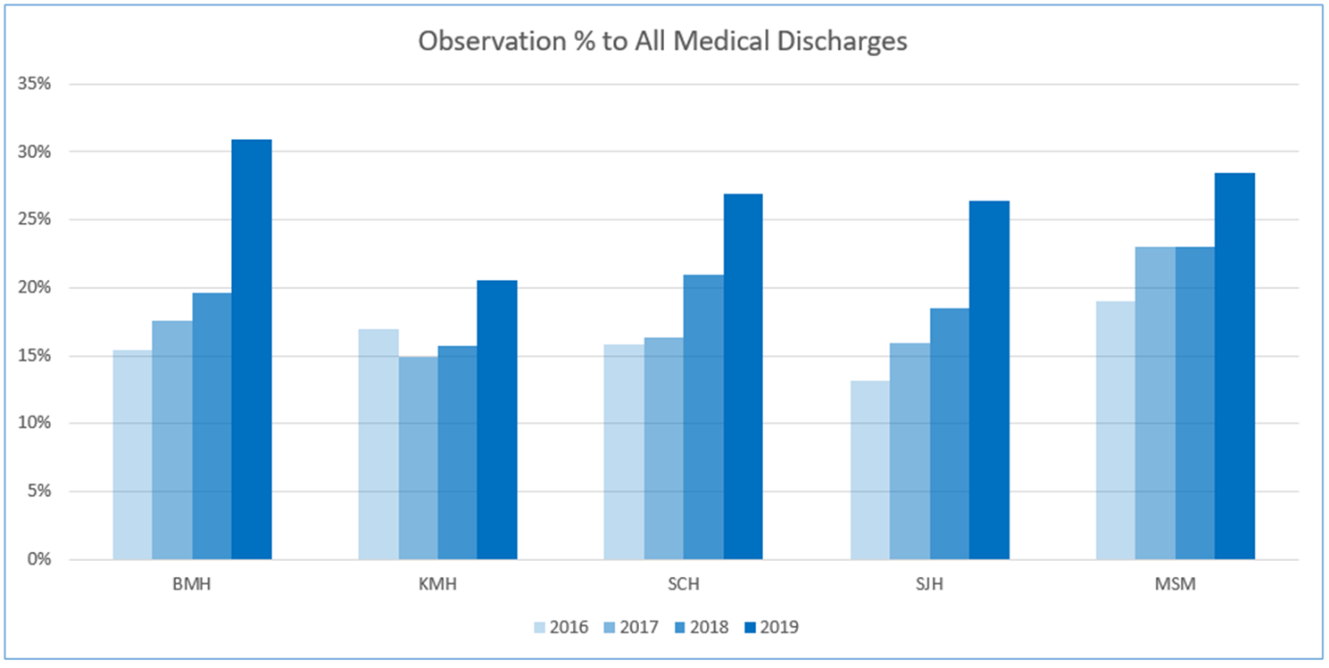
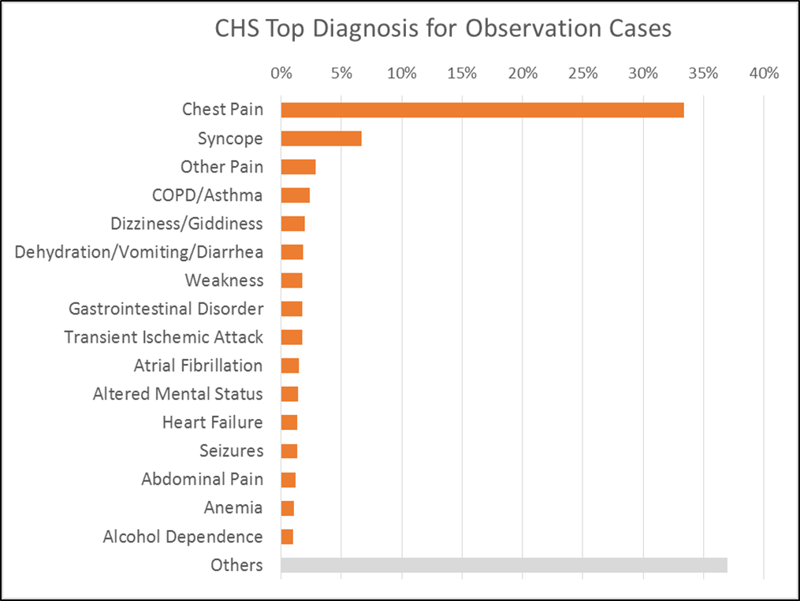
Key Findings: Observation Population
Obs discharges as a percent of medical discharges are climbing significantly
Chest Pain makes up nearly 1/3 of Obs discharges at each hospital
Notes:
Why is this important? Why now? Simply put, our observation population is rising significantly. As expected, chest pain and syncope remain the largest cohort of observation patients in the system. Changes in insurer guidelines and their payment strategies , however , have forced a larger amount of diagnoses that, perhaps, previously may have been full admissions, into observation status. It is expected that this number will only continue to rise further. In order to approach this challenge properly, it is imperative that we develop a model that will manage this population effectively and efficiently.

Slide 5
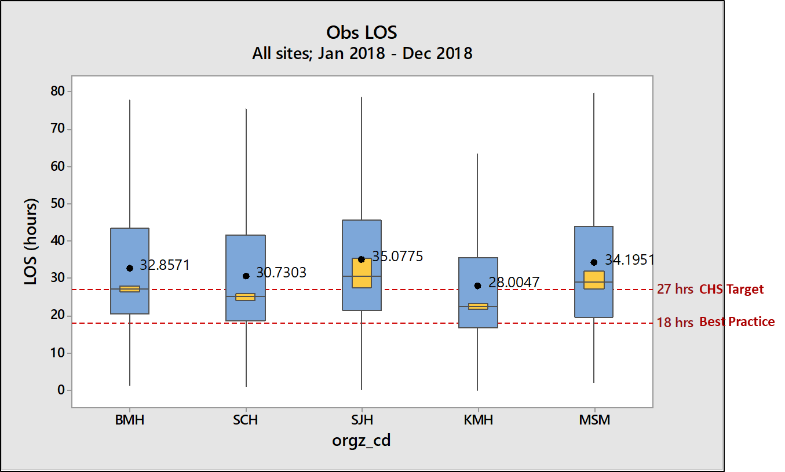
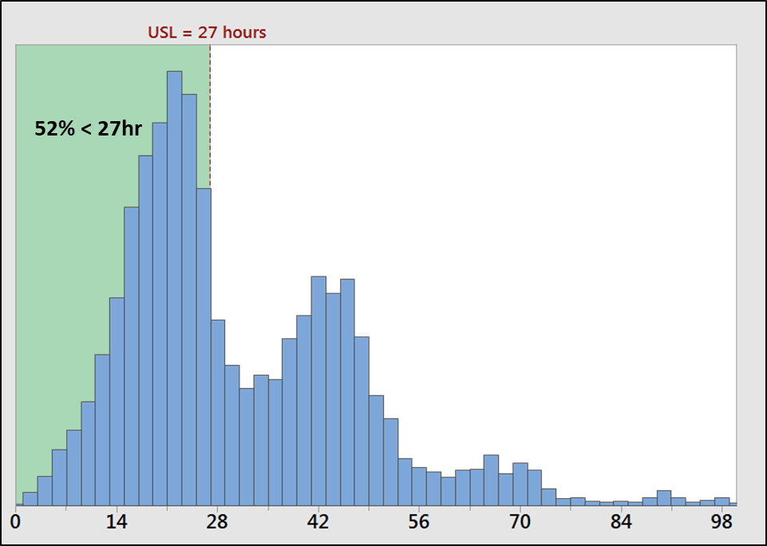
Key Findings: Observation LOS
CH Observation LOS ranks near the bottom of the national comparative
Obs LOS pattern is highly indicative of IP management – (24 hr. intervals)
  Also highly predicated on time of arrival – (Hour of Day and Day of Week)
Notes:
As is readily apparent here, we at the Catholic Health System have plenty of room for improvement. The recognized best practice target is 18 hours, and none of our facilities can claim to be measuring up. Recognizing where we are as a system, with only about half of our observation patients being discharged in under 27 hours, we have decided to set our aim first at improvement, with further refinement thereafter hopefully leading to our goal of becoming a top decile performer. As you can see, our median LOS satnds currently around 30 hours. Our first goal is to reach a target of a 27 hour average.

Slide 6
Observation Patient LOS (hours) by Top Diagnosis
LOS in hours per observation case, excluding cases converted from Obs status to IP admission
Notes:
Opening up these numbers a little further allows us to see which specific diagnoses are driving our higher than hoped for average. Illustrated here, chest pain, which makes up a large portion of our observation population, largely does well when LOS is measured. However, further impact could still be made, even though this be construed as performing well. For example, with improved processes, either by correct patient stratification and obviation of unnecessary testing allowing for earlier discharge, or by better staffing and streamlined processes for ordered tests. Large impacts will be made in other diagnoses as well, either by developing standardized diagnosis-specific protocols, which will be discussed later, by identifying appropriate level of care sooner (i.e., placing pt as full admits sooner or changing from obs to IP sooner), or by improving processes in care delivery. Currently, up to 35 percent of those patients initially placed under observation become admitted, a number which must be improved upon. Identified areas of improvement include: adjusting testing times,nursing and case mgmt staffing, multidisciplinary rounds, avoidance of unnecessary testing, appropriate provider availability, etc. The aim of this initiative is to at least begin to address all of the actionable areas which will positively impact our care delivery. The review of our current models reveals that the largest differences can be made with changes in PROCESSES as opposed to being provider driven .

Slide 7
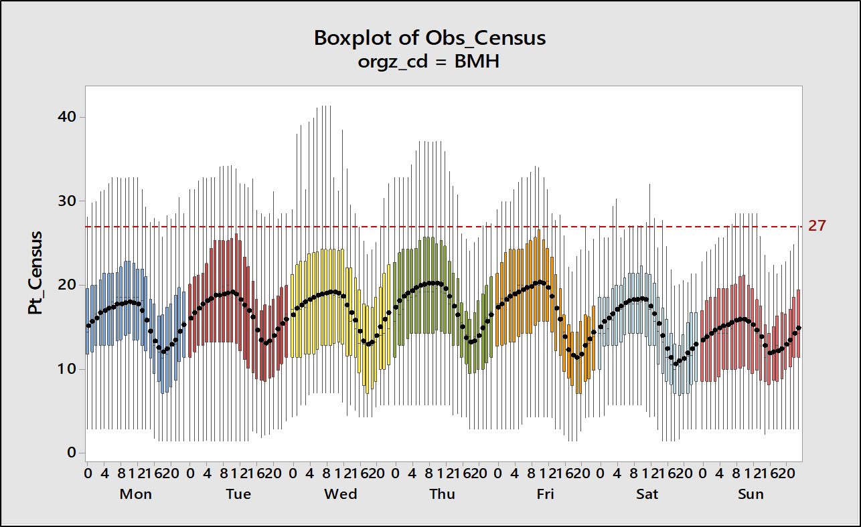
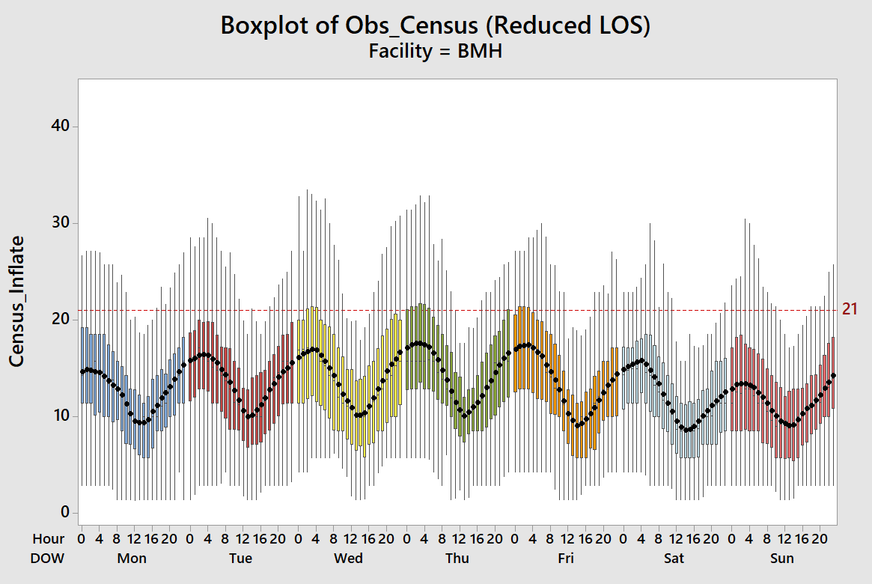
Impact of Observation Census with Reduced LOS
How would Obs Census be impacted if the target of 27 hours was met?
Notes:
What if we are able to achieve our goals. This slide demonstrates the observation census, plotted as the average week, at our Buffalo Mercy campus. As you see on the right, the census is heavily influenced by: time of day as well as day of patient arrival. This dovetails with what one would expect, with census peaking in the morning given overnight and early morning admissions, and decreasing as the day goes on. One would expect that the observation census would be higher early in the week, also, given lack of available staffing and certain testing modalities, and then improves later in the week. With improved LOS, the daily census would be less across each facility, lessening the strain of resources and allowing better facility management, in addition to the obvious financial benefits to the system. The predicted impact of the 27 hour goal is expected to reduce facility capacity requirements by up to 20 percent.

Slide 8
Observation Unit Type Comparison
Observation Unit Type | Staffing | Space | Ancillary Support | Advantages | Disadvantages
Type I: Protocol Driven/Dedicated OU | Dedicated staff (RNs) Training to specific procedures and documentation Generally closed unit Mid-level staffing possible w/ oversight | Distinct space for observation patients Often near ED | Focused on diagnostic turnaround Often shared with ED | Best patient outcomes and LOS Lowest admission ratios EBM Space standards “outpatient” | Dedicated space may constrain capacity Smaller hospital with lower volumes – may not be cost effective
Type II: Discretionary Care/Dedicated OU | Dedicated staff (RNs) Training to specific procedures and documentation Generally open admissions Mid-level staffing suggested | Distinct space for observation patients Often near ED but also within inpatient units | Focused on diagnostic turnaround | Allows for cohorting of patients and staff Space standards “outpatient” | More difficult to expedite care due to multiple admitters and lack of clinical guidelines
Notes:
Given this information, we are now tasked with implementing the changes we need to attain our goals, and that is by developing a standardized model of care delivery. This becomes challenging for many reasons. First, with varying bed capacities, staffing and cultures between facilities, we must develop a model that, while being standardized, allows flexibility for issues with staffing and patient cohorting as well as the integration of each facilities unique culture. Several Observation Unit models exist, more than are listed here, though this will serve as a comparison. Whereas the first model, or type 1, would be most ideal, this is considered a ‘closed system’ with only a dedicated staff being allowed to manage the population. This model, however, would potentially be problematic, given the varying providers, be they hospitalists or private providers, and existing contractual structures between facilities and groups as well as exisiting hospitalists and their associated outpatient providers. Further, bed capacities and constraints between facilities may not allow a dedicated space for all observation patients, leading to an inability to correctly apply standards across the whole system. Our model at Catholic Health will be more in keeping with a type 2 model listed here. Though this leaves a potential for less than ideal metrics, It allows us to preserve existing contractual structures and provider autonomy while leaving flexibility for the actual geography and physical design of units across the system.

Slide 9
Observation Care
General Guiding Principals:
  Ultimately, observation care is decision-making care, which an overarching goal to make an informed and correct disposition decision quickly. Data collection and analysis that supports disposition decision-making is paramount and is a core focus for clinicians.
  Observation care is similar to ED and ICU patient care in regards to level of diagnostic intensity.
  Providers will need to deliver a higher-level of oversight on observation patients, given the need to make a disposition decision quickly. For example, providers will need to round more often on observation patients compared to inpatient patients.
  Observation care must be provided on a 24/7 basis, with no disruptions in provider and diagnostic access overnight or on the weekends.
Notes:
With that in mind, it must be stated that for all involved in the in this process, the goals must be clear. Though these are ‘outpatients’, they cannot be considered a lower level of care. In fact, the management must become more intense if we are to meet our goals, such as that seen in ED or critical care management. Care must be timely, Clinical status reviewed regularly and decisions made quickly if this is to succeed. This has to apply to every patient in our clinical decision units. If providers are unable to meet the demands of the processes, it will fail. Plainly stated, those providers who cannot meet the demands of the system will need to address their current practice habits , or otherwise make arrangements with providers who have demonstrated the appropriate capacities.

Slide 10
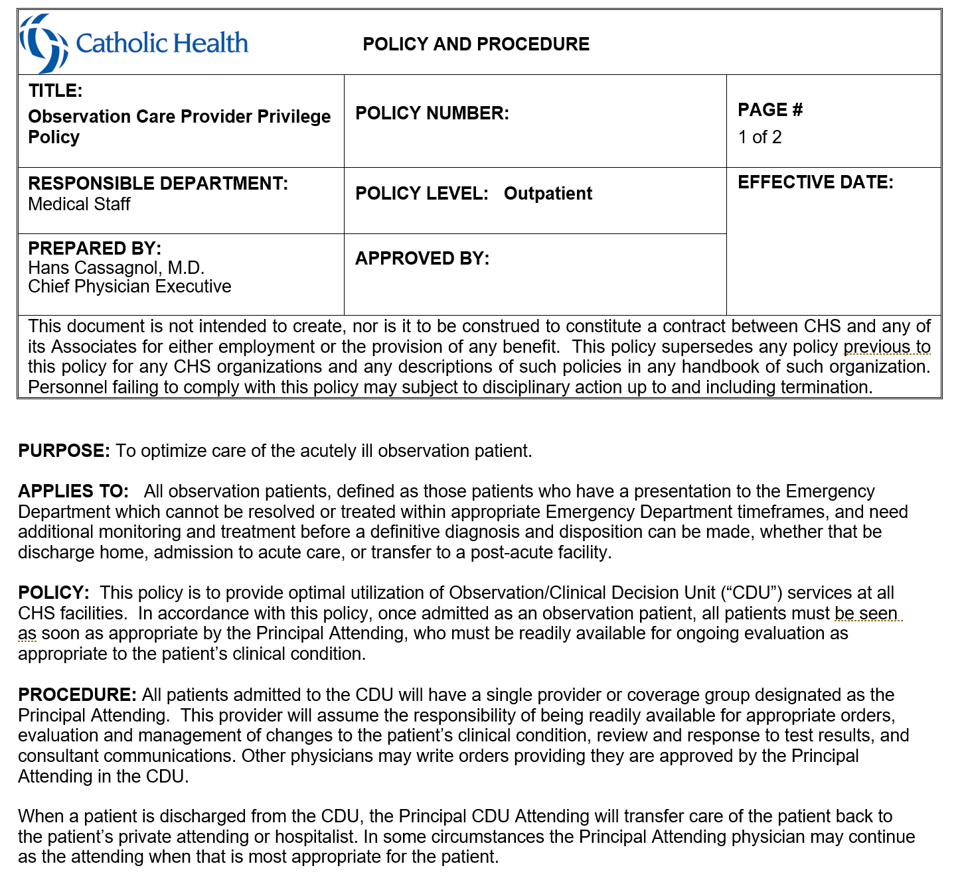
Observation Care
Provider Privilege Policy
Notes:
This policy has been developed, vetted and agreed upon at the system level and attempts to clearly delineate what will be required of those will care for observation patients. The main requirements of the providers, as you will see, are: presence, timeliness and process adherence. There is certain to be some consternation as some could see this policy as exclusionary. Let it be clear that there is no intention to penalize or exclude any one who wishes to care for their observation patients. However, the state of healthcare demands an adequate and immediate response and we must adapt. Further, nothing we are proposing is unique in itself: many systems throughout the country have adopted similar policies and some are even more restrictive.

Slide 11
Observation Care
Provider Privilege Policy
Notes:
Please familiarize yourself with the full requirements. These will be enforced, with some minimal variance. There are discussions, for example, that patients admitted after 6pm for observation will need to be evaluated by 8am as opposed to 7am, and that twice daily rounding with the multidisciplinary team is recommended but not required, but once daily rounding with MDR team will be required. If you feel as a provider that you cannot meet these requirements, it is recommended that you designate a provider or hospitalist group that will provide care for your observation patients. In the event that a provider designates a separate group or provider to care for their observation patients, they are most certainly not denied the ability to round on them, but all orders and process management while in the CDU are to come from only ONE source; they designated and privileged CDU provider, so as to eliminate confusion and promote standardization. Should a patient in observation require admission thereafter or have further change in status, the primary provider will then be expected to reassume care, unless and arrangement has been made otherwise, which can occur either on a global or case by case basis.
In regards to timing, it is expected that all patients admitted to observation are to be seen expeditiously as soon as possible. Ideally, this would be immediately and is expected where circumstances allow. Without exception, however, patients admitted during the day are to be seen on that same day. Patients admitted overnight are expected to be seen by 7am. Regardless, in ALL cases and at ALL times, the provider is to be ‘readily available’ as defined above

Slide 12
Observation Protocols/Order Sets
- Abdominal Pain
- Asthma/COPD Exacerbation
- Atrial Fibrillation
- Cellulitis
- Chest pain
-Dehydration/Nausea/Vomiting
Congestive Heart Failure
Pneumonia
Syncope
Transient Ischemic Attack
Vertigo/Dizziness
Notes:
In order to address the top 12 most prevalent conditions for which patients are admitted to CHS under Observation status, the following documents have been created to standardize care, reduce clinical practice variation, and produce the optimal outcome for patients. The forgoing is intended to provide guidance for physicians, nurses, and other practitioners staffing Clinical Decision Units across the system, and to allow for routinely high quality of care following evidence‐based standards. It is expected that deviation from these protocols will be justified medically and well documented.

Slide 13
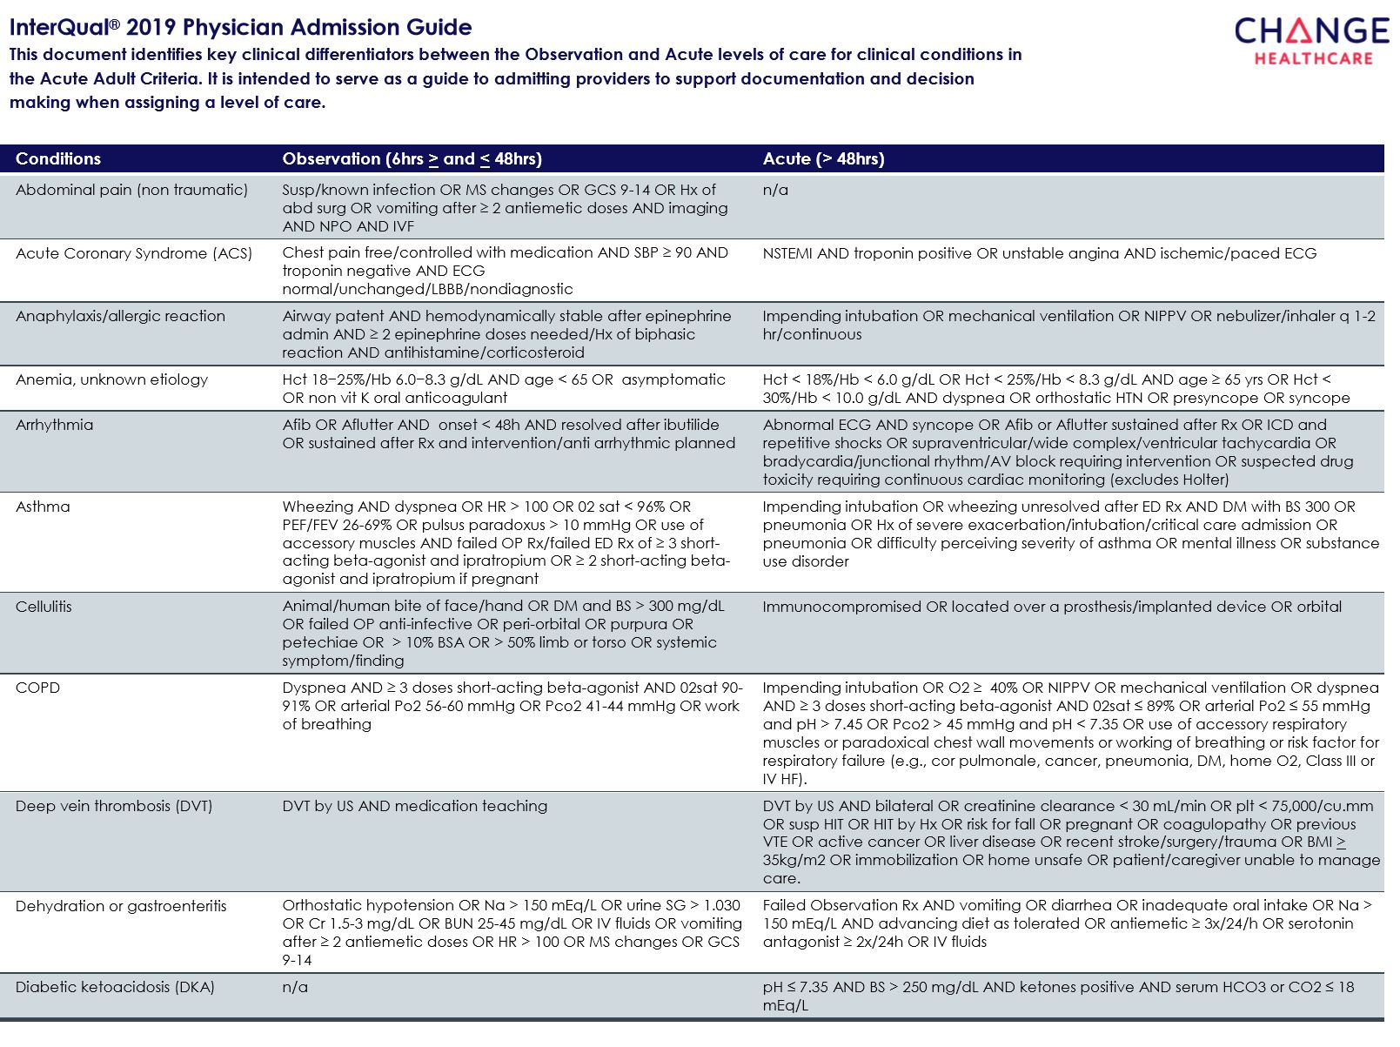
Notes:
These next two slides represent the latest guidelines from interqual regarding level of care determinations for common diagnoses. I would ask that all providers and groups become well versed in the criteria here, and referring to them frequently when decisions are being made. Failure to meet these criteria are certain to be denied. Also, I would advise that these are minimum criteria, and that, in some instances, even if observation criteria can be met, it may not necessarily require hospitalization. A way of thinking of this is that a patient needs to meet these criteria to be considered for further evaluation in the hospital, but not all patients that these criteria may need to be in the hospital. AN example would be the ill patient who is coming from a home hospice. IN the case of anemia here, patients with chronic anemia that can be proven with hemodynamic stability may not need to be brought in. This is where professional opinions can matter, so long as documentation can reflect the decision making.

Slide 14
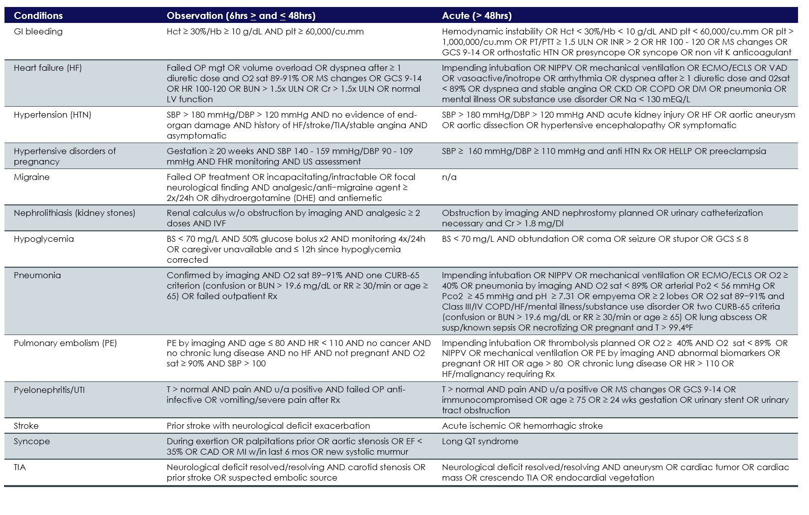
Notes:
Similarly here, the 65 year old patient with pneumonia who is saturating well and afebrile may not require observation so long as proper documentation can reflect that adequate follow up has been made and the proper discussions were had. These new criteria show that many of our old habits with diagnoses would not meet the scrutiny of current guidelines. Syncope, for example, a very common observation diagnosis, has relatively stringent criteria for observation.

Slide 15
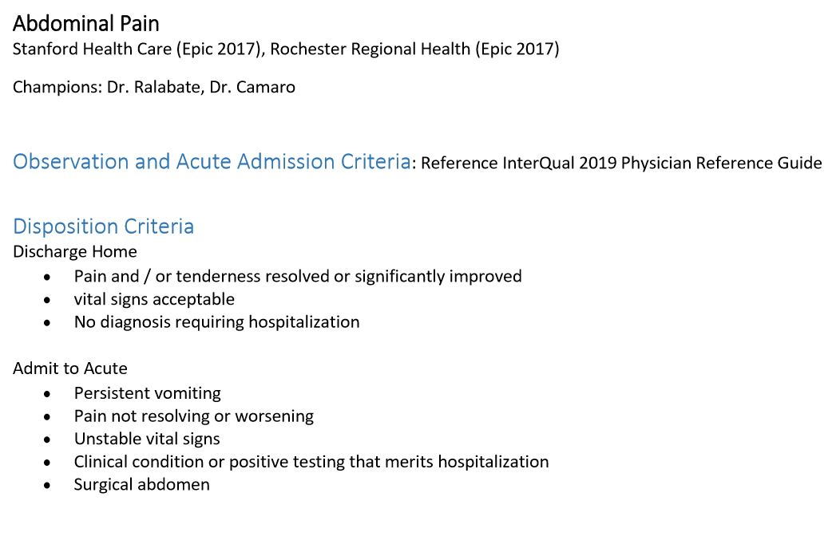
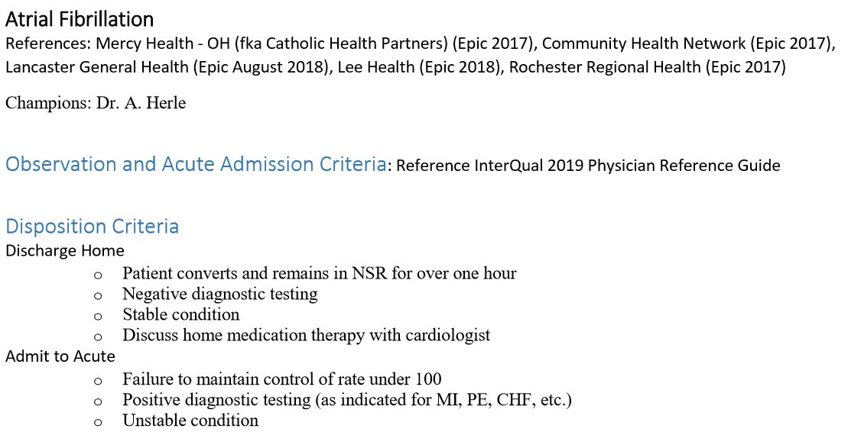
Notes:
On a system level, diagnosis specific champions were nominated to develop criteria and order sets to guide the decision making in regards to common diagnoses in hopes of standardization and streamlining the decision making process, and we thank them for their input. In this instance for example, Drs. Ralabate and Camara helped develop the abdominal pain protocol, where Dr. Herle was involved in the atrial fibrillation protocol The next several slides are meant to introduce you to the guidelines and order sets developed and agreed upon by these experts. These are presented to serve as an introduction, though they are available for download for full review via the links at the end of this presentation.
In all of these diagnoses, referring back to the previous Interqual guidelines will provide initial disposition criteria for either discharge home, observation or full admission. Thereafter, the series of order sets and disposition criteria listed have been developed in hopes of standardizing the hospital management and throughput.
I will reference, again, that, once a patient is agreed upon into observation, early recognition of when a patient should be changed into admission is critical. Considerations are listed under the Disposition criteria. The sooner we can identify and transition qualifying observation patients into admission, our metrics will improve significantly.

Slide 16
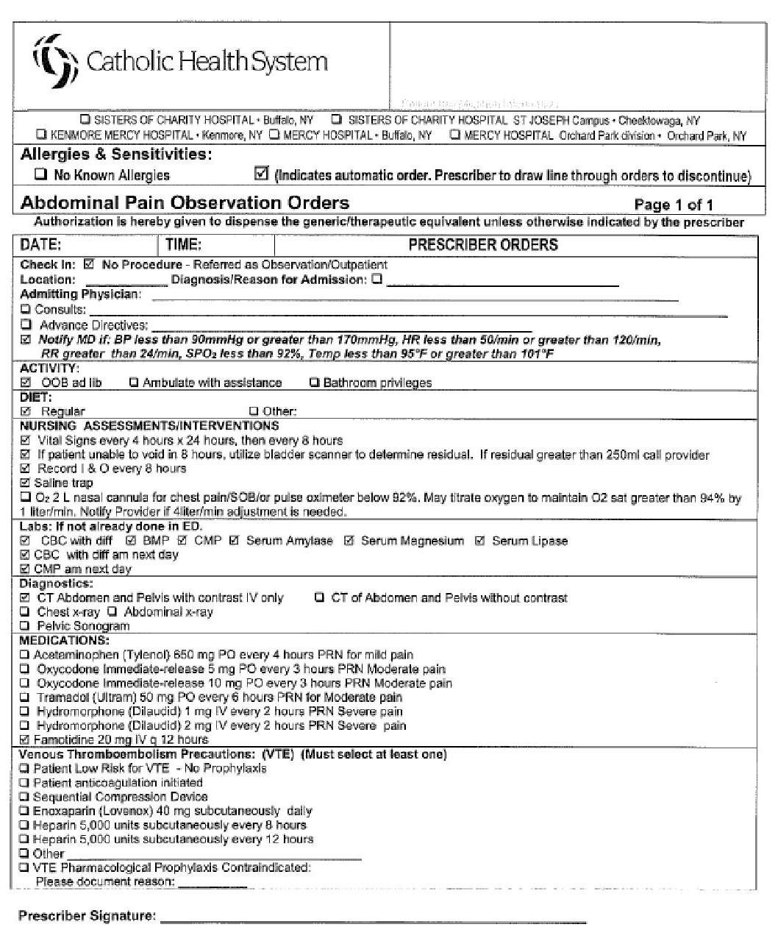
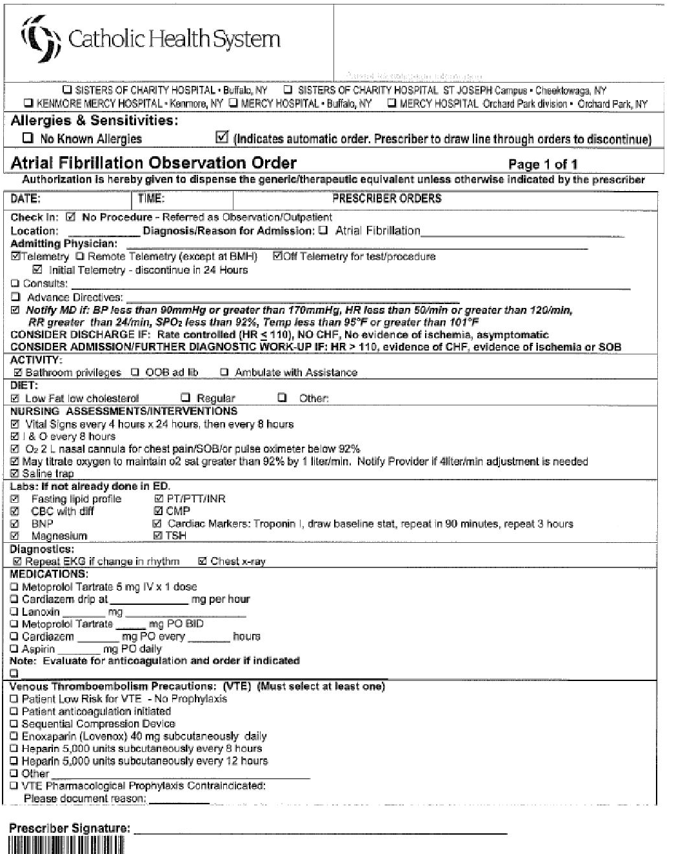
Notes:
Order sets have been generated for all of the core diagnoses, and an example is listed here. Observation providers are required to use the appropriate order sets as opposed to blank sets or generic orders. These order sets will be available on the CHS server, but it is expected that the Soarian versions will be used exclusively unless system issues arise where backup plans are initiated. I would recommend you familiarize yourselves with what is available and required. Further, links are provided at the end of this presentation to direct you to the full, clean set of order sets.

Slide 17
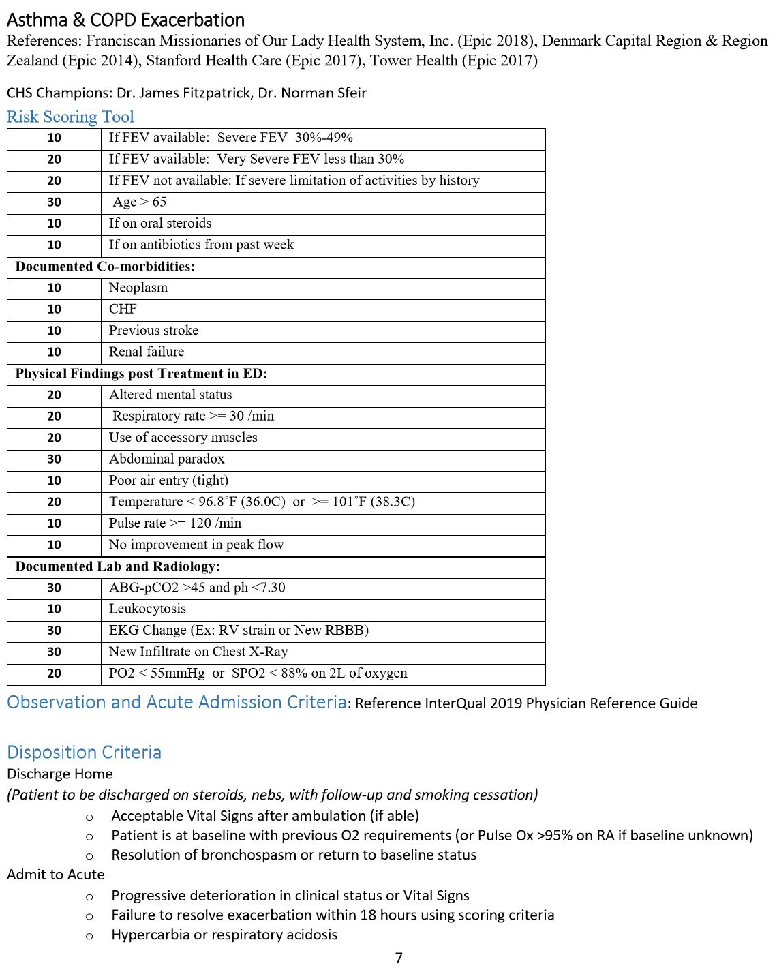
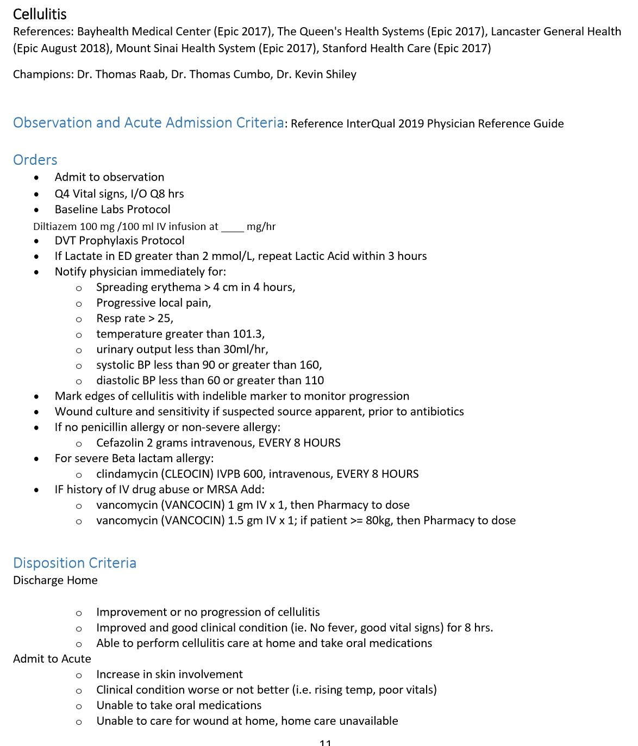
Notes:
The next several slides continue to show what has been devised by the chosen leaders for the specific diagnoses for your review.

Slide 18
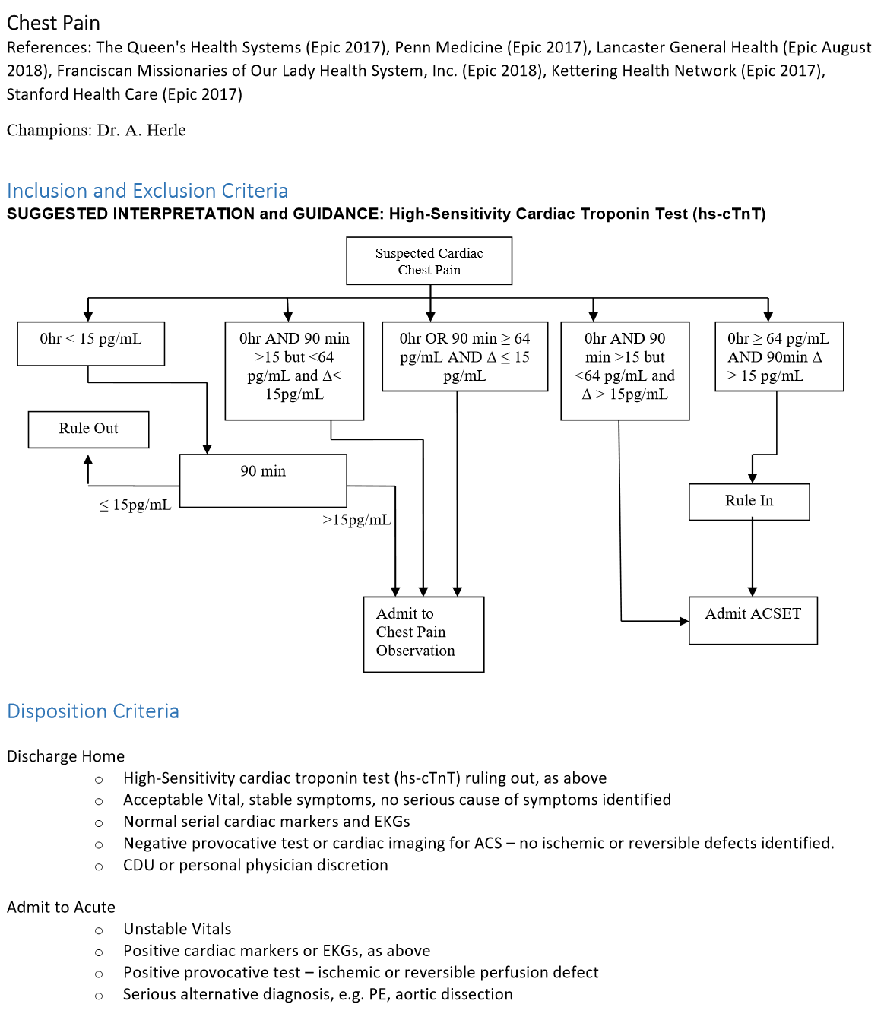
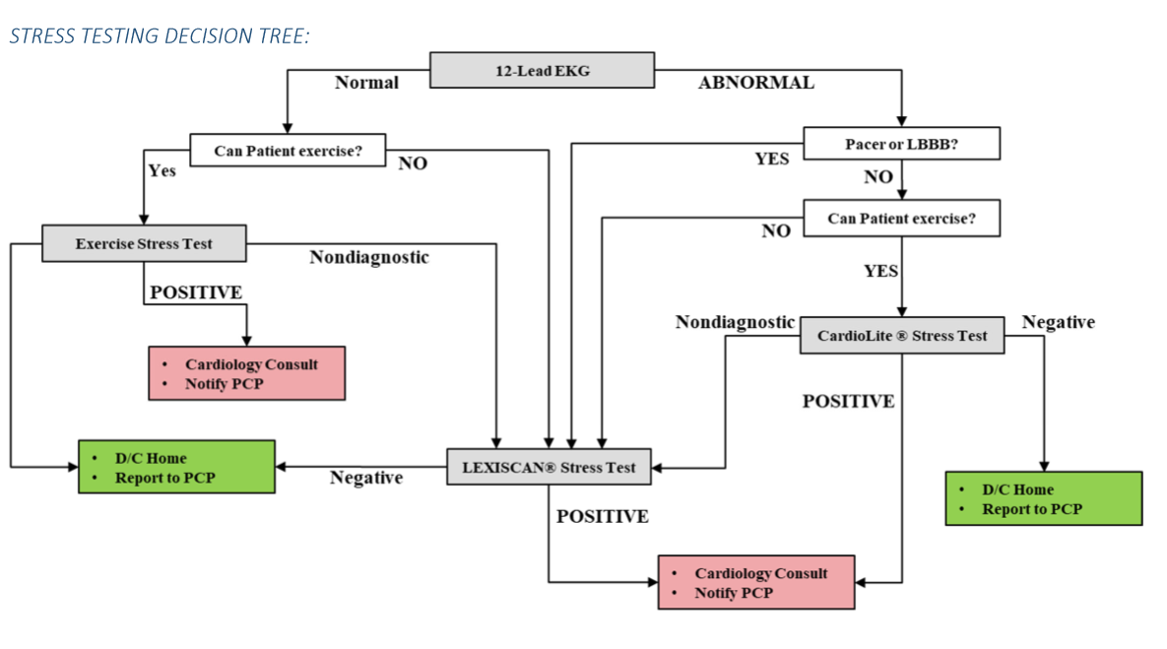
Notes:
Chest pain remains a diagnosis where we can realize significant effect. The advent of the new troponin assays will be reviewed separately. The algorithms here represent the ideal process we are hoping to attain. Keys here are recognizing which low risk patients could be considered for discharge from the ED to have further outpatient testing, and which types of testing, when needed, are recommended. Correct choices in testing will lead to less stress exerted on the cardiac testing and radiology staff, and less time waiting for reports to be generated. Further, the avoidance of unnecessary cardiology consults will also lead to improved disposition times.

Slide 19
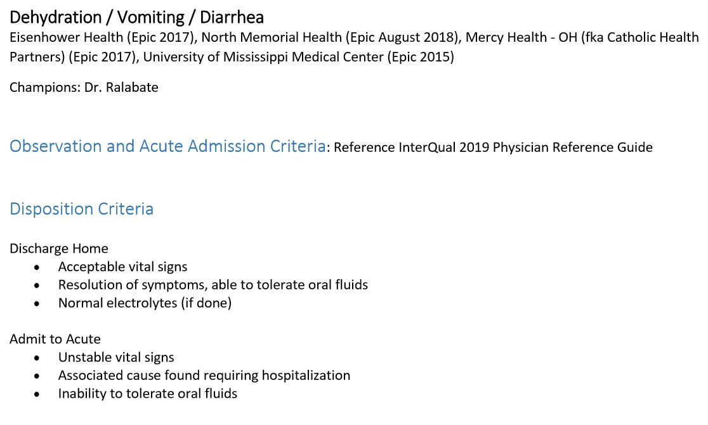
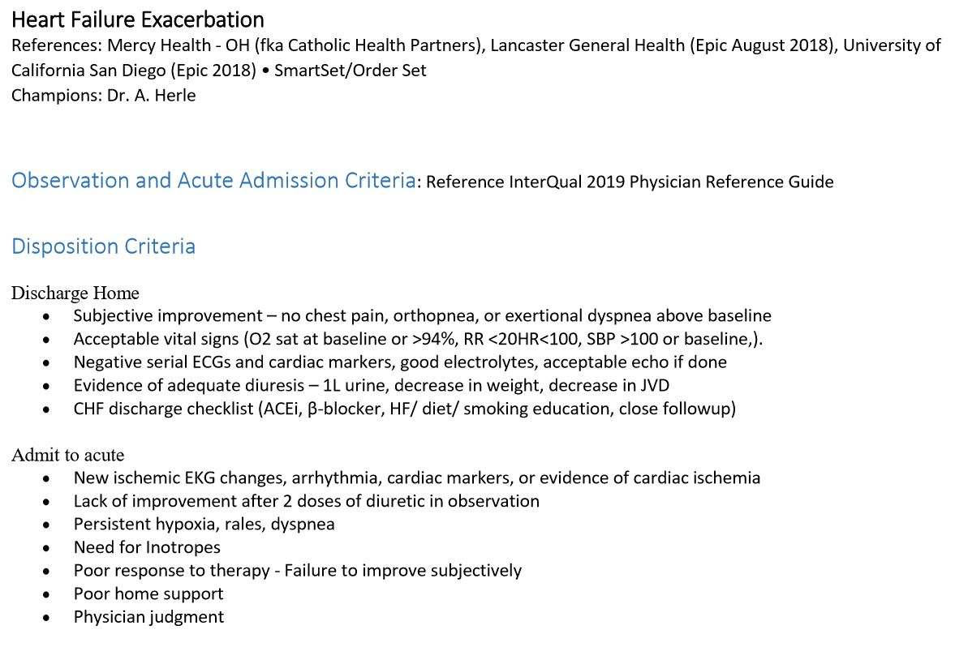

Slide 20
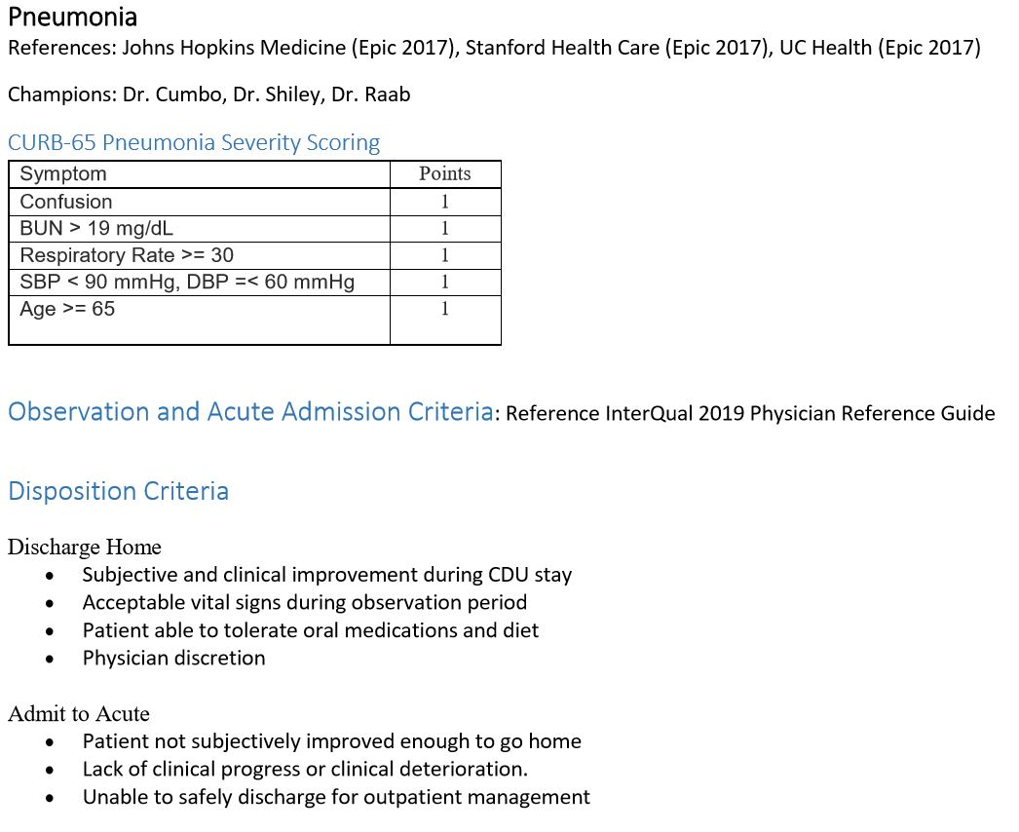
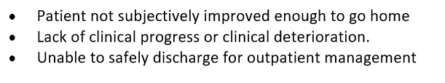
Notes:
Frequent reference to CURB-65 criteria are made in the Interqual guidelines, and, as we are all aware, this has been an effective risk stratification tool for pneumonia severity that bears revisiting.

Slide 21
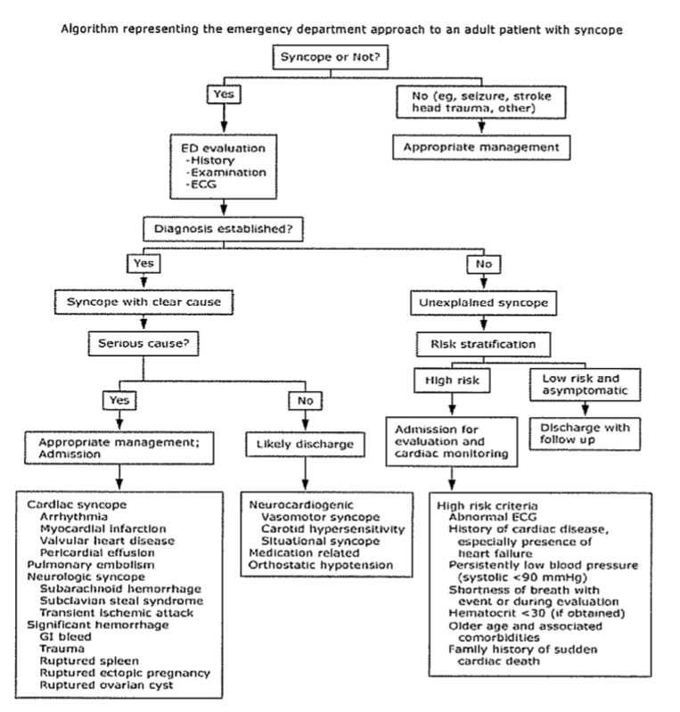
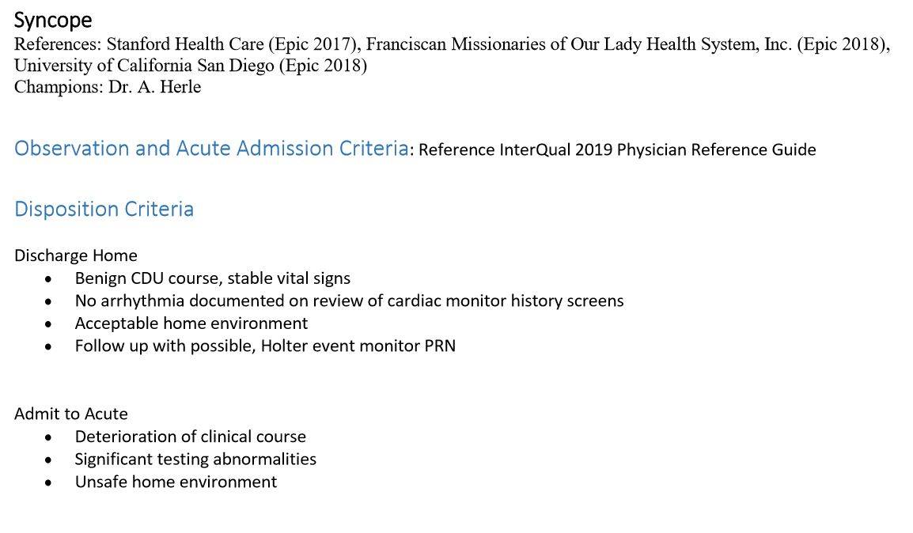
Notes:
Syncope remains a high volume observation diagnosis as well. This algorithmic approach has been developed and helps to clearly stratify the risk of syncope, which is largely based on an accurate history. A great deal of unnecessary and wasteful testing can occur if we allow ourselves to use a blanket approach. Rather, we should manage our resources more effectively in reserving inpatient and observation diagnostic testing for those patients who present with high risk criteria or serious associated diagnoses.

Slide 22
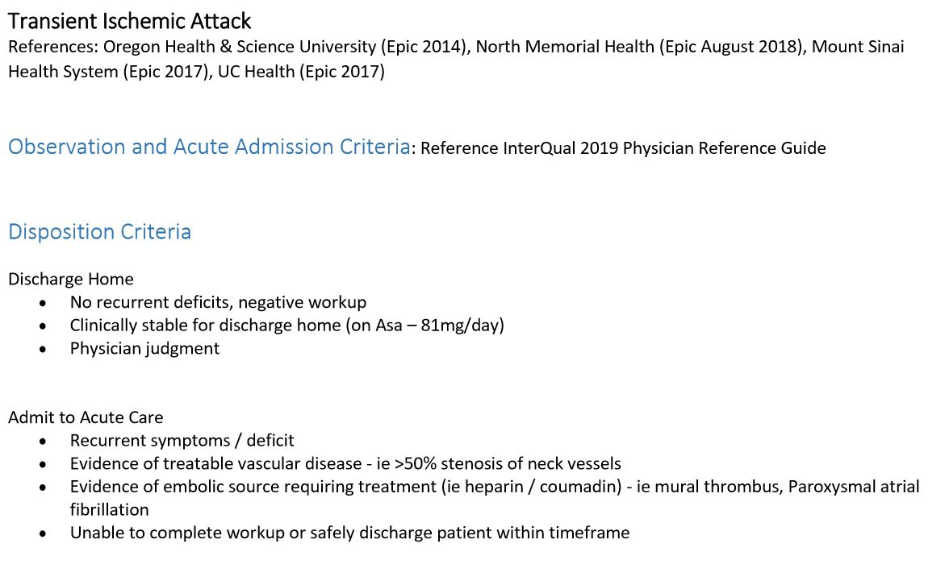
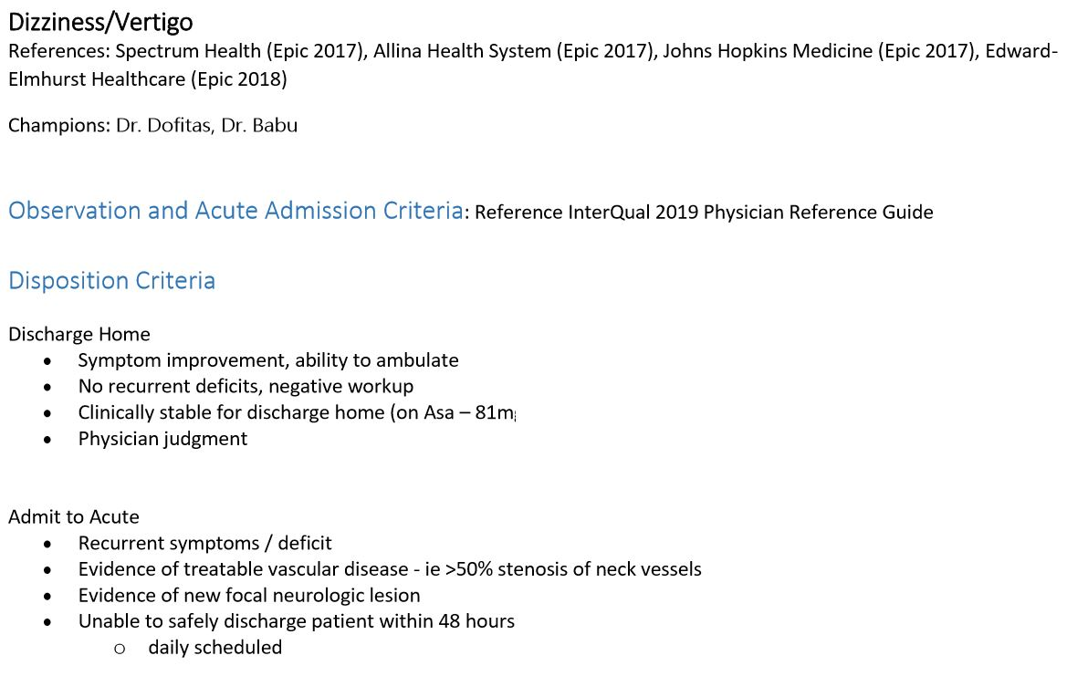

Slide 23
Local Physician Leaders
Buffalo Mercy – Dr. Thomas Raab
Sisters/St. Joseph’s – Dr. Norman Sfeir
Mt. St. Mary’s – Dr. Thomas Cumbo, Jr.
Kenmore Mercy – Dr. Eric Koch
Notes:
For further issues or concerns that may not have been addressed satisfactorily within this framework, I would direct you to your local site leaders as listed here. Net learning will also be coming for staff to review. There are certain to be growing pains and ongoing discussions, all with the intention of providing better standardized care to our patients while improving system metrics. Any input you may have will be accepted gladly and used to further improve the process. We at Catholic Health are very excited about the potential this initiative provides. We look forward to partnering with all of our providers and associates to realize our goals, and we thank you for your time and consideration.

Slide 24
Click on the image of the following for links to downloadable content:
- Observation Order Sets
- InterQual Criteria
- Attestation Page
Notes:
The following links will direct you to sites for further independent review of the criteria and order sets. I would recommend you download them and keep them where they are readily accessible for reference. Further, you will need to print out and sign the attestation page and return to your local Medical Staff office.

